Slide 1
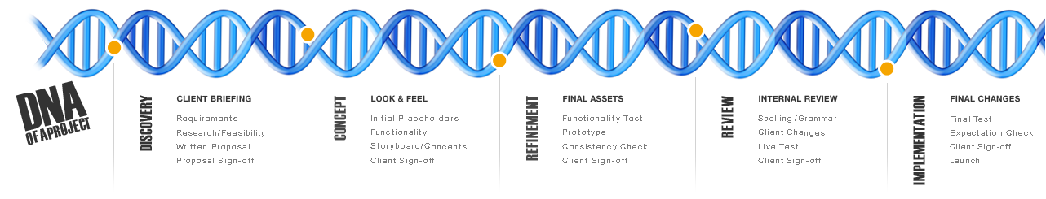
Introduction to Single Cell RNA Sequencing
Sarah Boswell
Director of the Single Cell Core, Harvard Medical School
Director of Sequencing Technologies, Laboratory of Systems Pharmacology
Staff Scientist/Sequencing Specialist, Systems Biology, Springer Lab
https://singlecellcore.hms.harvard.edu/
sarah_boswell@hms.harvard.edu

Slide 2
Introduction to Single Cell RNA Sequencing
Common applications of single cell RNA sequencing.
Overview of single cell RNA sequencing platforms.
Sample preparation and experimental design.
Effects of sample prep and sample type on analysis.
Notes:
The first step in single cell sequencing is deciding if you need scRNASeq for your question. Bulk vs scRNA
For a crispr screen the bulk would tell you about the phenotype you selected on, but not yield any information on the effect due to an individual k/o

Slide 3
Bulk vs Single Cell RNA Sequencing (scRNA-seq)
average expression level
comparative transcriptomics
disease biomarker
homogenous systems
Bulk RNA-seq
Population 1
define heterogeneity
identify rare cell population
cell population dynamics
Population 2
scRNA-seq
Population 3
Population 4
Notes:
The first step in single cell sequencing is deciding if you need scRNASeq for your question. Bulk vs scRNA
For a crispr screen the bulk would tell you about the phenotype you selected on, but not yield any information on the effect due to an individual k/o

Slide 4
Transcriptome Coverage (mRNA)
mRNA: TruSeq RNA-Seq (gold standard)
~20,000 transcripts
More when consider splice variants / isoforms
Observe 80-95% of transcripts depending on sequencing depth
Single Cell Methods
200 -10,000 transcripts per cell
Observe 10-50% of the transcriptome
Many transcripts will show up with zero counts in every cell (eg. GAPDH, ACTB).
If you only looked at transcripts observed in all cells numbers drop dramatically.
Low Input Methods
4000-6000 transcripts per sample
Limiting to transcripts observed across all samples
Observe 20-60% of the transcriptome
Notes:
Why do I say that? - Let’s start by remembering that most scRNAseq methods are mRNA – polyA tail based – so if you are looking for non polyadenylated transcripts most scRNAseq methods won’t work for you. What I really want you to understand is the data quality you can expect in a scRNA compared to standard RNAseq
If you do a standard mRNAseq with 20M reads per sample….low input….single cell.
scRNAseq – need 40-60 thousand reads per cell; compare to the 20M reads per sample of standard RNAseq – 350-500 cells for that 20M reads
scRNAseq can be very powerful but you want to be sure it the best method to answer your scientific question.

Slide 5
The World Between Bulk & scRNA-Seq
 | Deep RNA-Seq | Sort-Seq | Low input | scRNA-Seq
Transcriptome Coverage | High | High | Moderate | Low
Throughput | Moderate | Low | High | Low
Cell Subtype Information | None | Moderate | None | High
Sequencing Depth | Moderate | Moderate | Low | High
Cost per Sample | Moderate | Moderate | Low | High
Notes:
While this is a class on scRNA-seq data analysis, so obviously you are all intersted in that. I think it is important that you are aware that it isn’t always the best answer for your scientific question. In fact I was just working with a researcher who was interested in a few transcripts in particular in a neuronal subtype – when she looked at existing data she realized her transcript was showing up in so few cells that sorting and doing a bulk sequencing on the sorted cells would be better for her.

Slide 6
Common Applications of scRNA-seq
Studying heterogeneity
Lineage tracing study
Stochastic gene expression
X
X
OFF state
ON state
t₀
t₁
t₂
Slow transition of promoter
Fast transition
of promoter
Heterogenous tissue
Cell differentiation
Rel. freq.
Rel. freq.
Component1
Component1
mRNA copies
mRNA copies
Bimodal
distribution
Unimodal
distribution
Component2
Component2
Liu S and Trapnell C. Single-cell transcriptome sequencing: recent advances and remaining challenges, F1000 Research 2016 (doi: 10.12688/f1000research.7223.1)
Junker and van Oudenaarden; Every Cell Is Special: Genome-wide Studies Add a New Dimension to Single-Cell Biology, Cell 2014 (doi: 10.1016/j.cell.2014.02.010)
Liu S and Trapnell C. Single-cell transcriptome sequencing: recent advances and remaining challenges, F1000 Research 2016 (doi: 10.12688/f1000research.7223.1)
Junker and van Oudenaarden; Every Cell Is Special: Genome-wide Studies Add a New Dimension to Single-Cell Biology, Cell 2014 (doi: 10.1016/j.cell.2014.02.010)
Notes:
Looking a little more closely at the standard scRNA-Seq applications.
Again if your looking at heterogeneity in a population, but you really only have 2 pretty homogenous populations then you are probably better off sorting and looking at bulk RNAseq
While these applications of scRNA-Seq sound great it is important to be realistic and understand the kind of data you can expect from scRNAseq

Slide 7
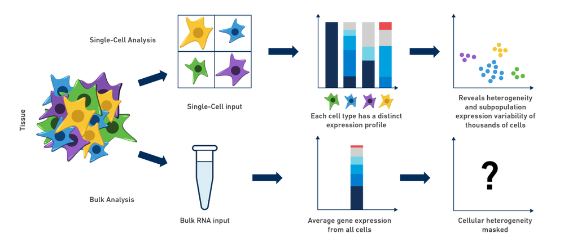
Tumor, Tissue, Organoid Heterogeneity
https://community.10xgenomics.com/t5/10x-Blog/Single-Cell-RNA-Seq-An-Introductory-Overview-and-Tools-for/ba-p/547
Notes:
See a lot with Immune cells, Brain – in our core we have helped with studies on organoids, lung, tumor etc. - Often use previously established marker gene sets to help identify clusters

Slide 8
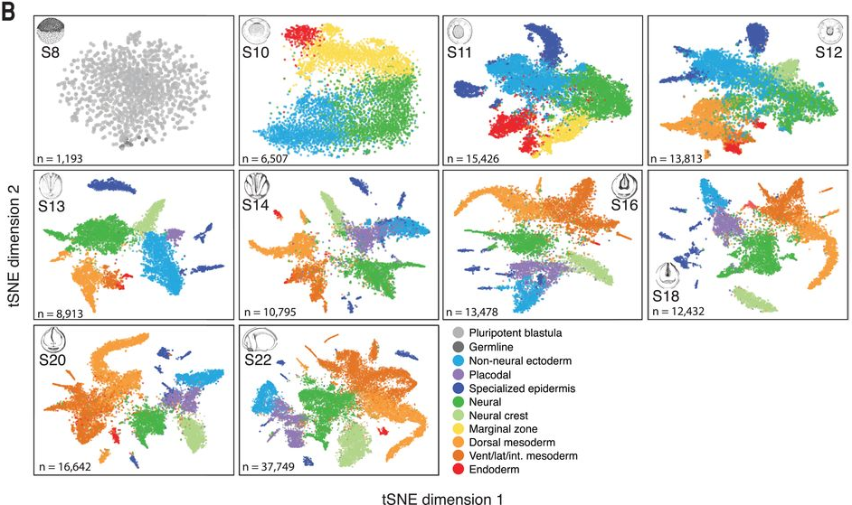
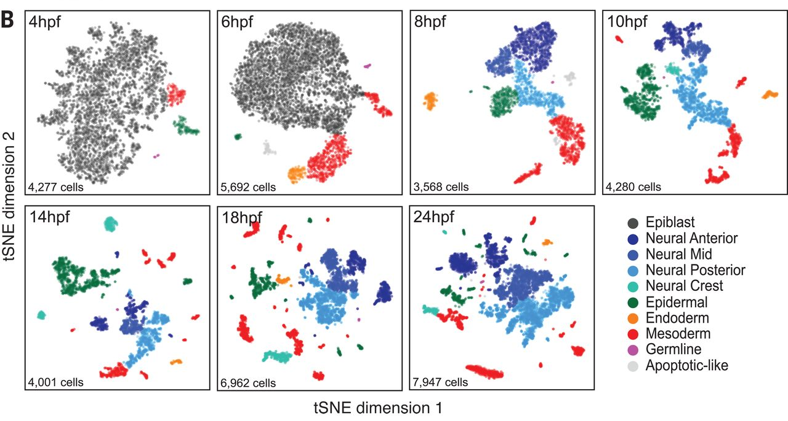
Development Lineage Tracing
Frog
Zebrafish
JA. Briggs et al. The dynamics of gene expression in vertebrate embryogenesis at single-cell resolution, Science 01 Jun 2018 (DOI: 10.1126/science.aar5780)
DE Wagner et al. Single-cell mapping of gene expression landscapes and lineage in the zebrafish embryo, Science 01 Jun 2018 (DOI: 10.1126/science.aar4362)
Notes:
Frog embryo during 1st day of fertilization – can see through this low dimensional visualization the pattern increasing in complexity over time.

Slide 9
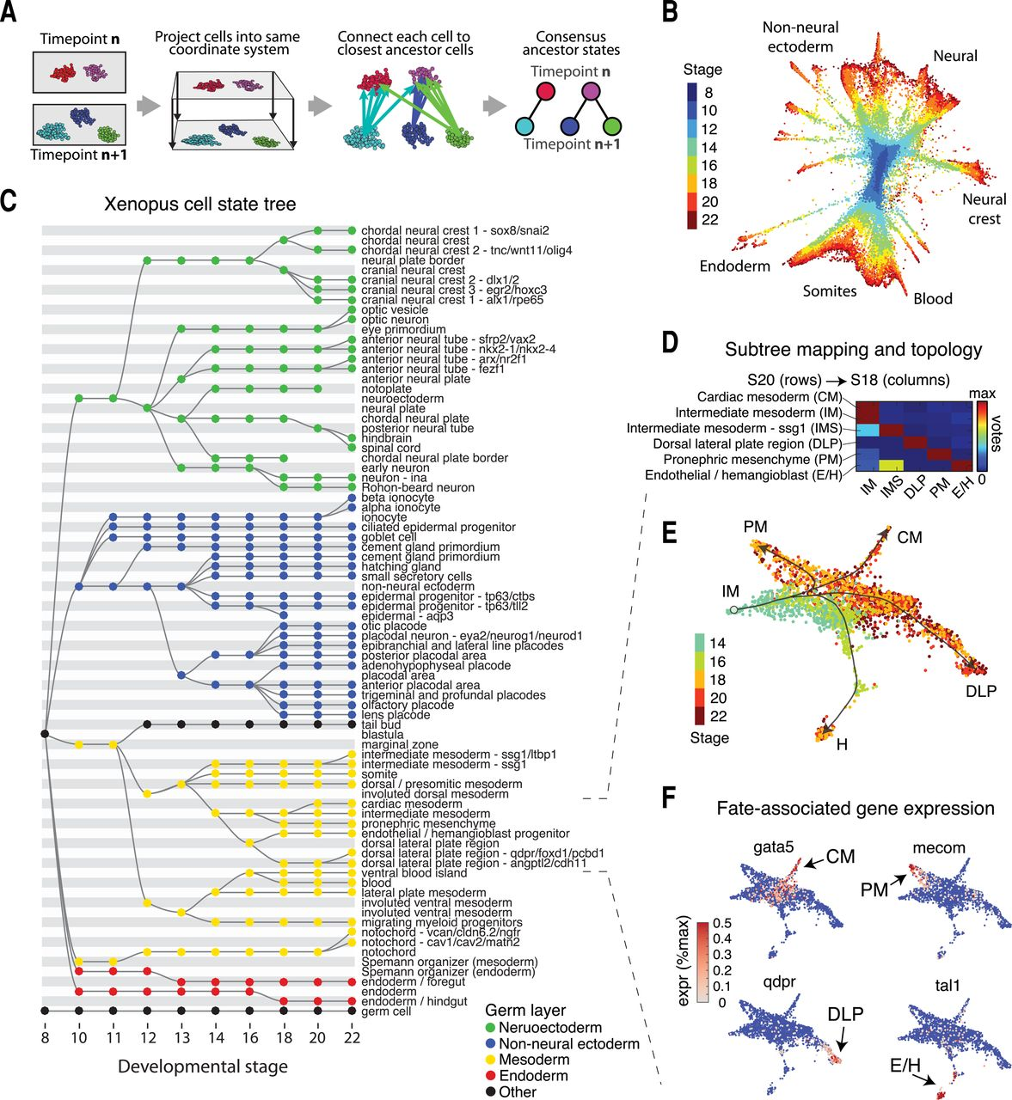
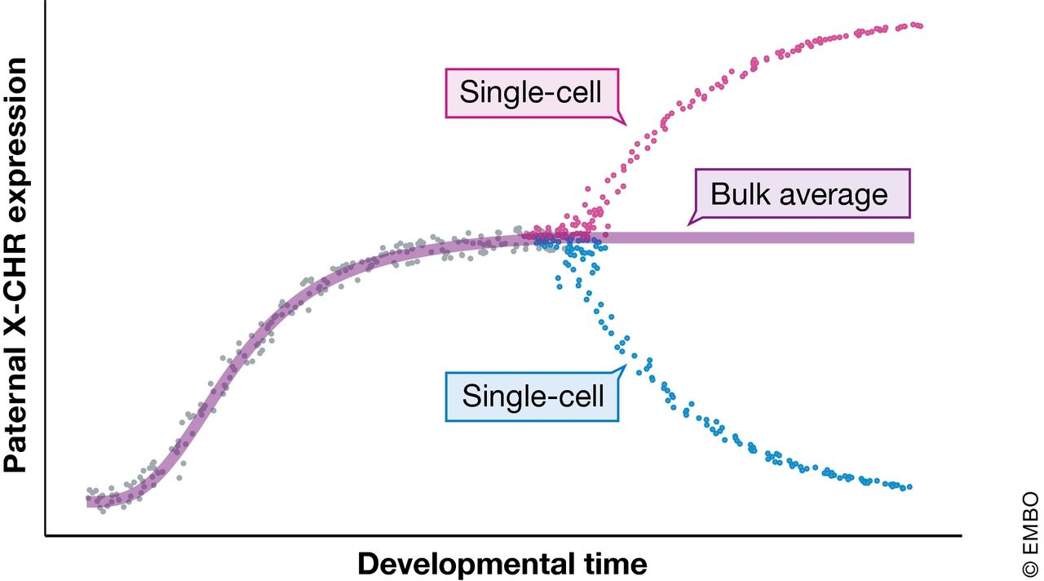
Development Lineage Tracing
JA. Briggs et al. The dynamics of gene expression in vertebrate embryogenesis at single-cell resolution, Science 01 Jun 2018 (DOI: 10.1126/science.aar5780)
JA. Griffiths et al. Using single‐cell genomics to understand developmental processes and cell fate decisions, MSB (2018) (DOI 10.15252/msb.20178046)
Notes:
Project cells based on gene sets found to closest neighbor to build tree

Slide 10
Stochastic Gene Expression
Gene expression is heterogeneous and “bursty”.
Genes fluctuate between “On” and “Off” promoter states.
Stochastic expression of one gene can propagate to generate more stochasticity in downstream genes.
Eldar & Elowitz; Functional roles for noise in genetic circuits, Nature 2010 (doi: 10.1038/nature09326)
B Hwang et al. Single-cell RNA sequencing technologies and bioinformatics pipelines, EMM 07 Aug 2018 (doi: 10.1038/s12276-018-0071-8)
Notes:
Gene expression is inherently stochastic. Random fluctuations of the mechanisms underlying mRNA and protein production cause heterogeneity among otherwise-identical cell populations
Studying stochastic gene expression in cells of the same type requires analysis of hundreds of cells, as well as accurate quantification.
Genes fluctuate between “On” and “Off” promoter state. Regulated by a complex interaction between different transcription factors and chromatin-modifying factors.
However, the low mRNA capture efficiency of scRNA-seq makes it difficult to draw definitive conclusions about allele-specific or isoform-specific expression at the single-cell level

Slide 11
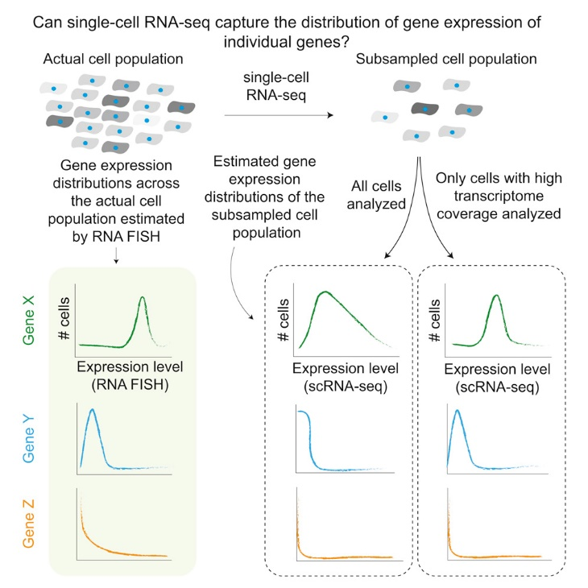
Stochastic Gene Expression
Low mRNA capture efficiency of scRNA-seq makes it difficult to draw definitive conclusions about expression at the single-cell level.
Number of cells and depth of sequencing critical for understanding rare gene expression phenotypes.
E Torre et al. Rare Cell Detection by Single-Cell RNA Sequencing as Guided by Single-Molecule RNA FISH, Cell Systems 28 Feb 2018 (DOI: 10.1016/j.cels.2018.01.014)
Notes:
ingle-cell RNA sequencing (scRNA-seq) subsamples the actual transcriptome (left) to an observed transcriptome (middle). Different cells (horizontal rows) can have different degrees of transcriptome coverage. Depending on the number of cells analyzed, the observed expression distribution for any particular gene may not reflect the true distribution (right). We schematically depicted three classes of genes: high, minimally variable expression (GAPDH); low, minimally variable expression (SPP1); and rare cells with high expression (NGFR). As the number of genes involved in biology decrease then the coverage requirements increase – because you need to ensure you see those few genes of interest.

Slide 12
More Cells or More Sequencing Reads?
Required number of cells increases with complexity of the sample.
As the number of genes involved in the biology decrease then the coverage requirements increase (more reads).
Cell-type classification of a mixed population usually requires lower read depth and can be sequenced at 10,000-50,000 reads per cell.
We typically suggest starting with 25,000-55,000 reads per cell. You can always re-sequence your samples.
A. Hague et al. A practical guide to single-cell RNA-sequencing for biomedical research and clinical applications, Genome Med 2017 (DOI: 10.1186/s13073-017-0467-4)
JA. Griffiths et al. Using single‐cell genomics to understand developmental processes and cell fate decisions, MSB (2018) (DOI 10.15252/msb.20178046)
Notes:
No 1 size fits all answer for best scRNAseq project.
If you want to see all subtypes in a sample expected to have 4 subpopulations = need fewer cells than if sample has 10 subpopulations
If many genes define the differences in the 4 or 10 subpoulations (as is often the case in development) easy to find the many populations. If only a handful of genes, then need to sequence deeper

Slide 13
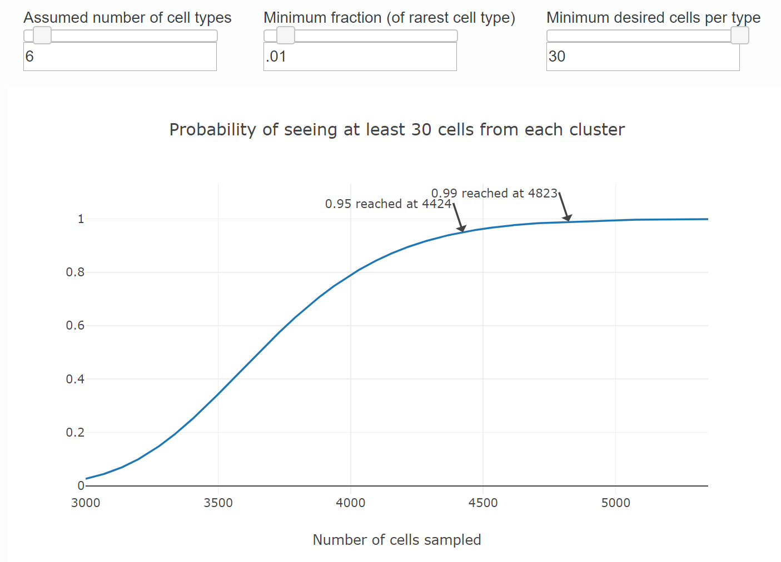
https://satijalab.org/howmanycells
Notes:
NEED fresh sample – can cryopreseve or try Nuc Seq

Slide 14
Common applications of scRNA-seq
Studying heterogeneity
Lineage tracing study
Stochastic gene expression
X
X
OFF state
ON state
t₀
t₁
t₂
Slow transition of promoter
Fast transition
of promoter
Heterogenous tissue
Cell differentiation
Rel. freq.
Rel. freq.
Component1
Component1
mRNA copies
mRNA copies
Bimodal
distribution
Unimodal
distribution
Component2
Component2
Liu S and Trapnell C. Single-cell transcriptome sequencing: recent advances and remaining challenges, F1000 Research 2016 (doi: 10.12688/f1000research.7223.1)
Junker and van Oudenaarden; Every Cell Is Special: Genome-wide Studies Add a New Dimension to Single-Cell Biology, Cell 2014 (doi: 10.1016/j.cell.2014.02.010)
Liu S and Trapnell C. Single-cell transcriptome sequencing: recent advances and remaining challenges, F1000 Research 2016 (doi: 10.12688/f1000research.7223.1)
Junker and van Oudenaarden; Every Cell Is Special: Genome-wide Studies Add a New Dimension to Single-Cell Biology, Cell 2014 (doi: 10.1016/j.cell.2014.02.010)
Notes:
Simplest / most straightforward single cell studies are those involving understanding cell heterogeneity. Lineage tracing and stoichasisity require much more sophisticated analytical understanding and tools.

Slide 15
Introduction to Single Cell RNA Sequencing
Common applications of single cell RNA sequencing.
Overview of single cell RNA sequencing platforms.
Sample preparation and experimental design.
Effects of sample prep and sample type on analysis.
Notes:
The first step in single cell sequencing is deciding if you need scRNASeq for your question. Bulk vs scRNA
For a crispr screen the bulk would tell you about the phenotype you selected on, but not yield any information on the effect due to an individual k/o

Slide 16
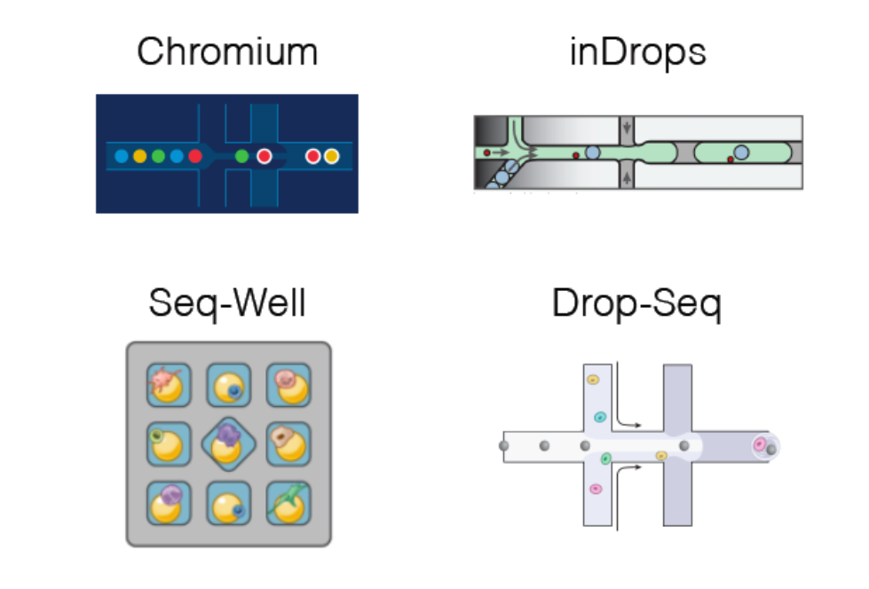
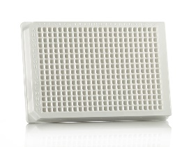
Comparison of Single Cell Methods
Chromium (10x)
inDrops
CELL-Seq
MARS-Seq
SMART-Seq
SCRB-Seq
Seq-Well
Drop-Seq
Notes:
All the plate based methods – SMART-seq is the top pick. Then have the microfluidic droplet based methods. And lastly Seq-Well and some other nano-well methods are starting to pop up.

Slide 17
Comparison of Single Cell Methods
 | inDrops | 10x | Drop-seq | Seq-well | SMART-seq
Cell capture efficiency | ~70-80% | ~50-65% | ~10% | ~80% | ~80%
Time to capture 10k cells | ~30min | 10min | 1-2 hours | 5-10min | --
Encapsulation type | Droplet | Droplet | Droplet | Nanolitre well | Plate-based
Library prep | CEL-seq Linear amplification by IVT | SMART-seq Exponential PCR based amplification | SMART-seq Exponential PCR based amplification | SMART-seq Exponential PCR based amplification | SMART-seq Exponential PCR based amplification
Commercial | Yes | Yes | -- | -- | Yes
Cost (~$ per cell) | ~0.06 | ~0.2 | ~0.06 | -- | 1
Strengths | Good cell capture Cost-effective Real-time monitoring Customizable | Good cell capture Fast and easy to run Parallel sample collection High gene / cell counts | Cost-effective Customizable | Good cell capture Cost-effective Real-time monitoring Customizable | Good cell capture Good mRNA capture Full-length transcript No UMI
Weaknesses | Difficult to run | Expensive | Difficult to run & low cell capture efficiency | Still new! | Expensive
C. Ziegenhain et al., Comparative Analysis of Single-Cell RNA Sequencing Methods, Molecular Cell 2017 (doi: 10.1016/j.molcel.2017.01.023)
Notes:
In my remaining time just want to go over some of the high throughput low input methods we have available to us.

Slide 18
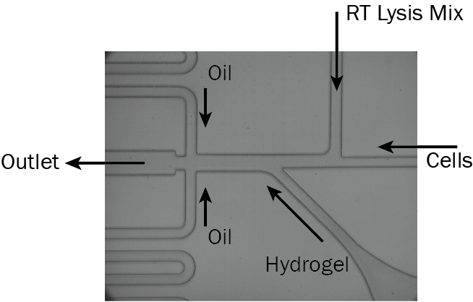
inDrops Method Overview
Single cell suspension injected at density of ~80,000 cells / ml
Matching the speed of bead injection with the speed of droplet generation it is possible to set conditions in which nearly every droplet would be loaded. one hydrogel bead
Notes:
“randomize order” mt, wt, wt mt etc

Slide 19
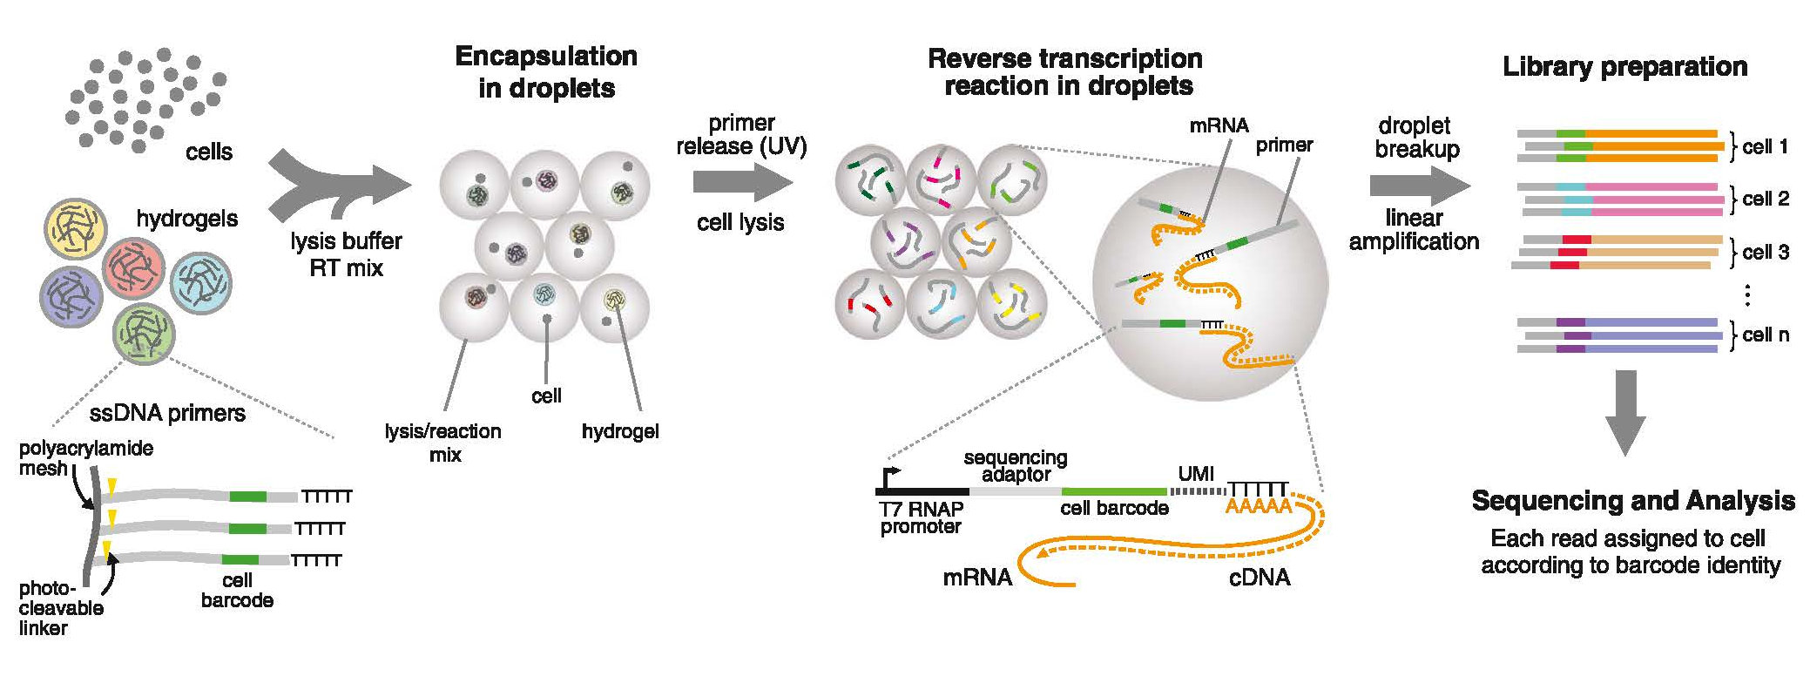
inDrops Method Overview
UMI (6N)
Lysis and reverse transcription occurs in the beads
Samples are frozen after RT as RNA:DNA hybrid in gel
Library prep is based on CEL-Seq method
A. M. Klein et al., Droplet barcoding for single-cell transcriptomics applied to embryonic stem cells, Cell 2015 (doi: 10.1016/j.cell.2015.04.044)
R. Zilionis et al., Single-cell barcoding and sequencing using droplet microfluidics, Nature Protocols 2016 (doi: 10.1038/nprot.2016.154 )
Notes:
Quick review of indrops – lysis buffer encountered right away, but is somewhat gentile and may not be immediate
6N UMI

Slide 20
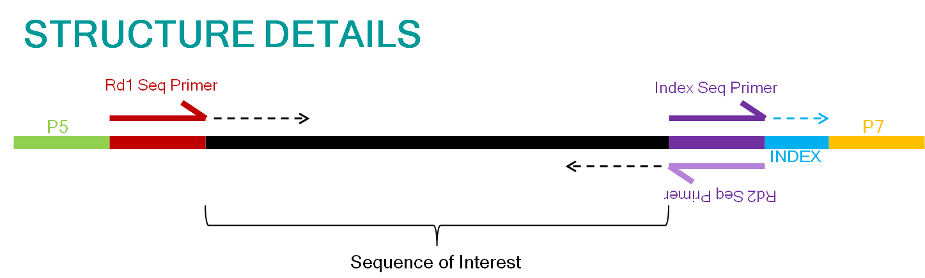
scRNA-seq Library Structure (inDrops)
Index 1 primer
INDEX
Barcode
Index 2 primer
Sequencing Read | Description | Number of Cycles | Notes
Read1 | Insert (Transcript) | 61 | Can read longer into transcript if desired
I7 index | Single Cell Barcode | 8 | Reads first half of barcode
I5 index | Library Index | 8 | Distinguish multiplexed samples
Read 2 | Single Cell Barcode & UMI | 14 | Reading longer will read into PolyA tail.
Notes:
All the plate based methods – SMART-seq is the top pick. Then have the microfluidic droplet based methods. And lastly Seq-Well and some other nano-well methods are starting to pop up.

Slide 21
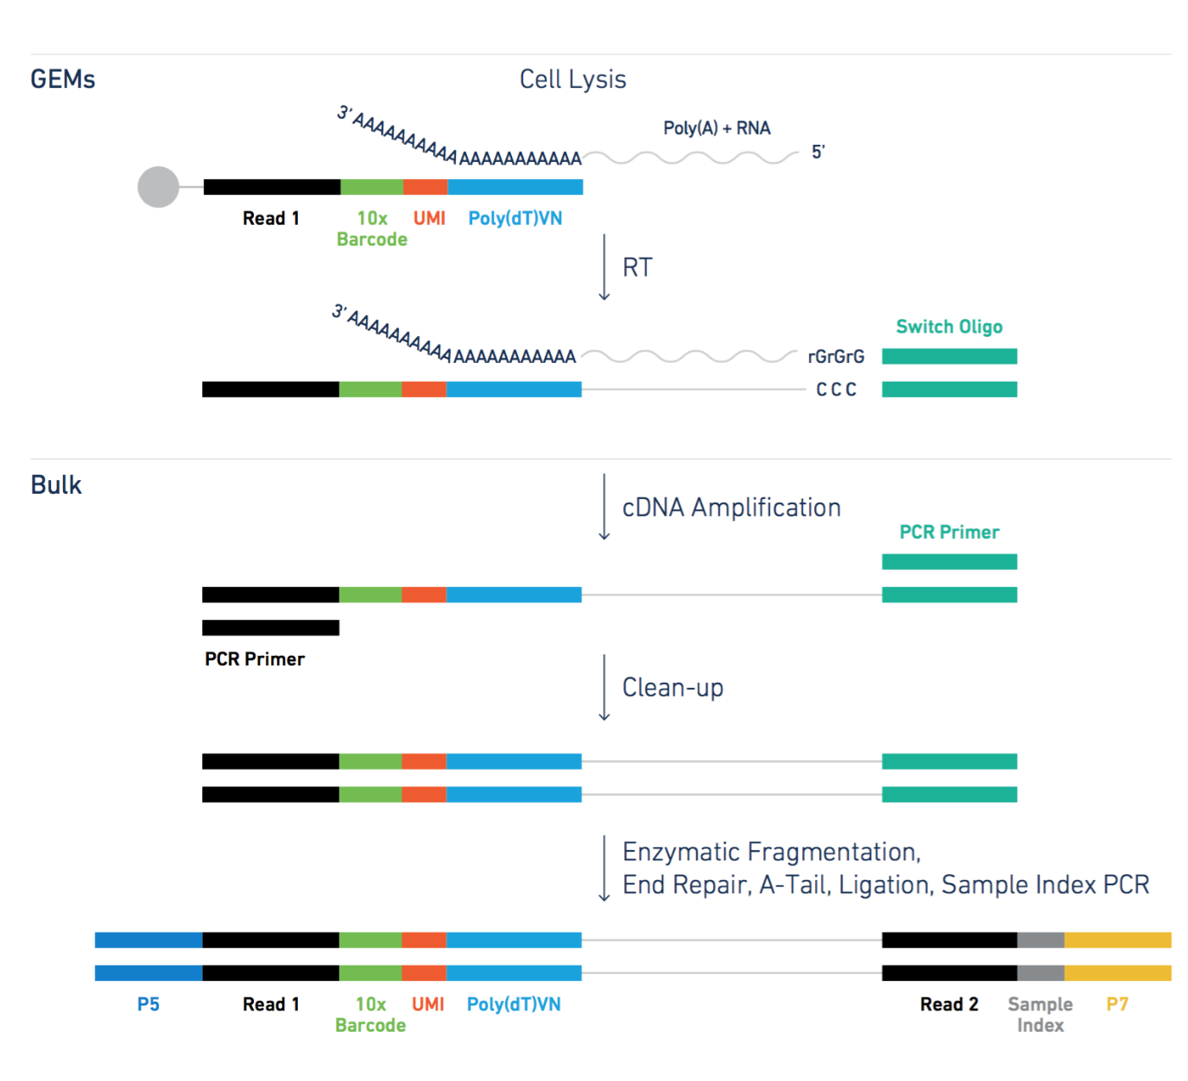
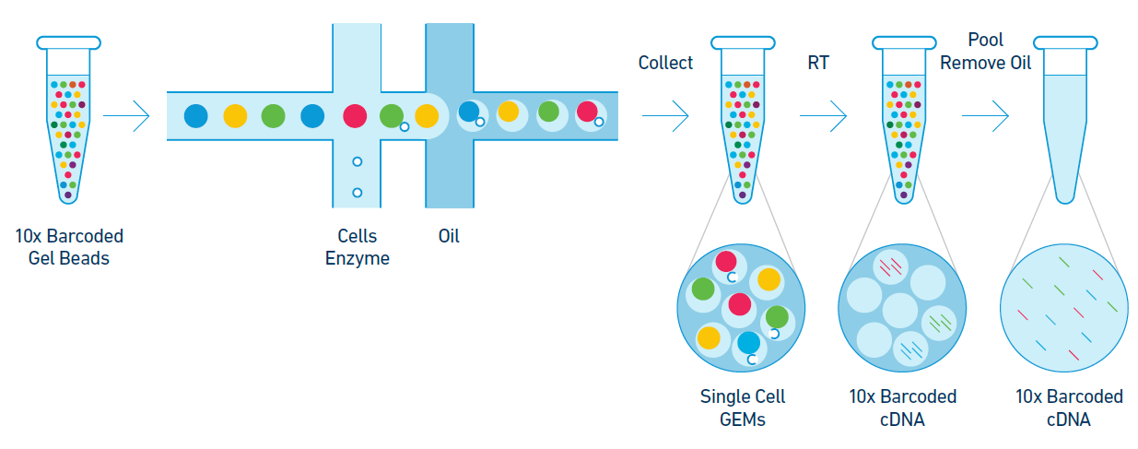
10x Genomics Method Overview
Lysis and reverse transcription occurs in the beads
Samples are frozen after RT as RNA:DNA hybrid in gel
Library prep is similar to SMART-seq method
Notes:
Quick review of indrops – lysis buffer encountered right away, but is somewhat gentile and may not be immediate
6N UMI

Slide 22
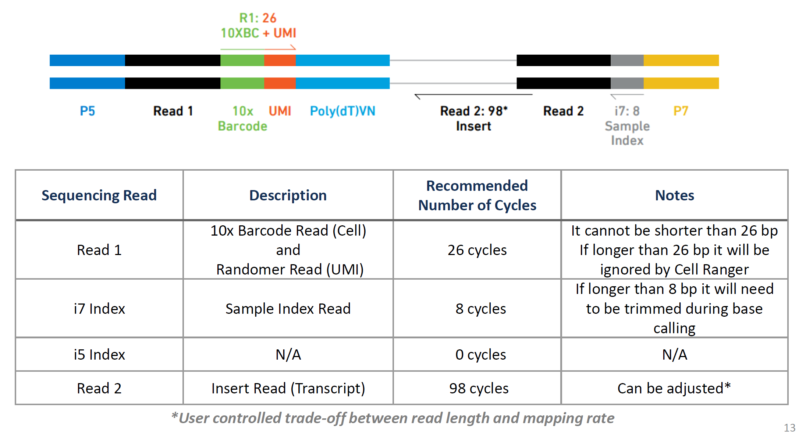
10x Genomics Method Overview
Notes:
Quick review of indrops – lysis buffer encountered right away, but is somewhat gentile and may not be immediate
6N UMI

Slide 23
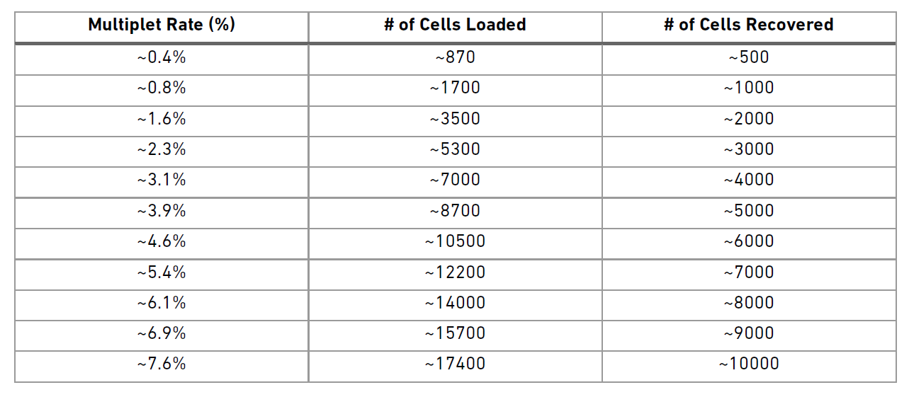
Doublets / Cell Density
Rate of doublets depends on the cell density and the flow rate used for encapsulation.
“Sweet spot” for loading a 10x is recovery of 5000-6000 cells.
https://support.10xgenomics.com/single-cell-gene-expression/sample-prep/doc/user-guide-chromium-single-cell-3-reagent-kit-v2-chemistry
Notes:
10x likes to say cost is ~12 cents per cell – but that is at the max cells, which has the highest doublet rate. It also

Slide 24
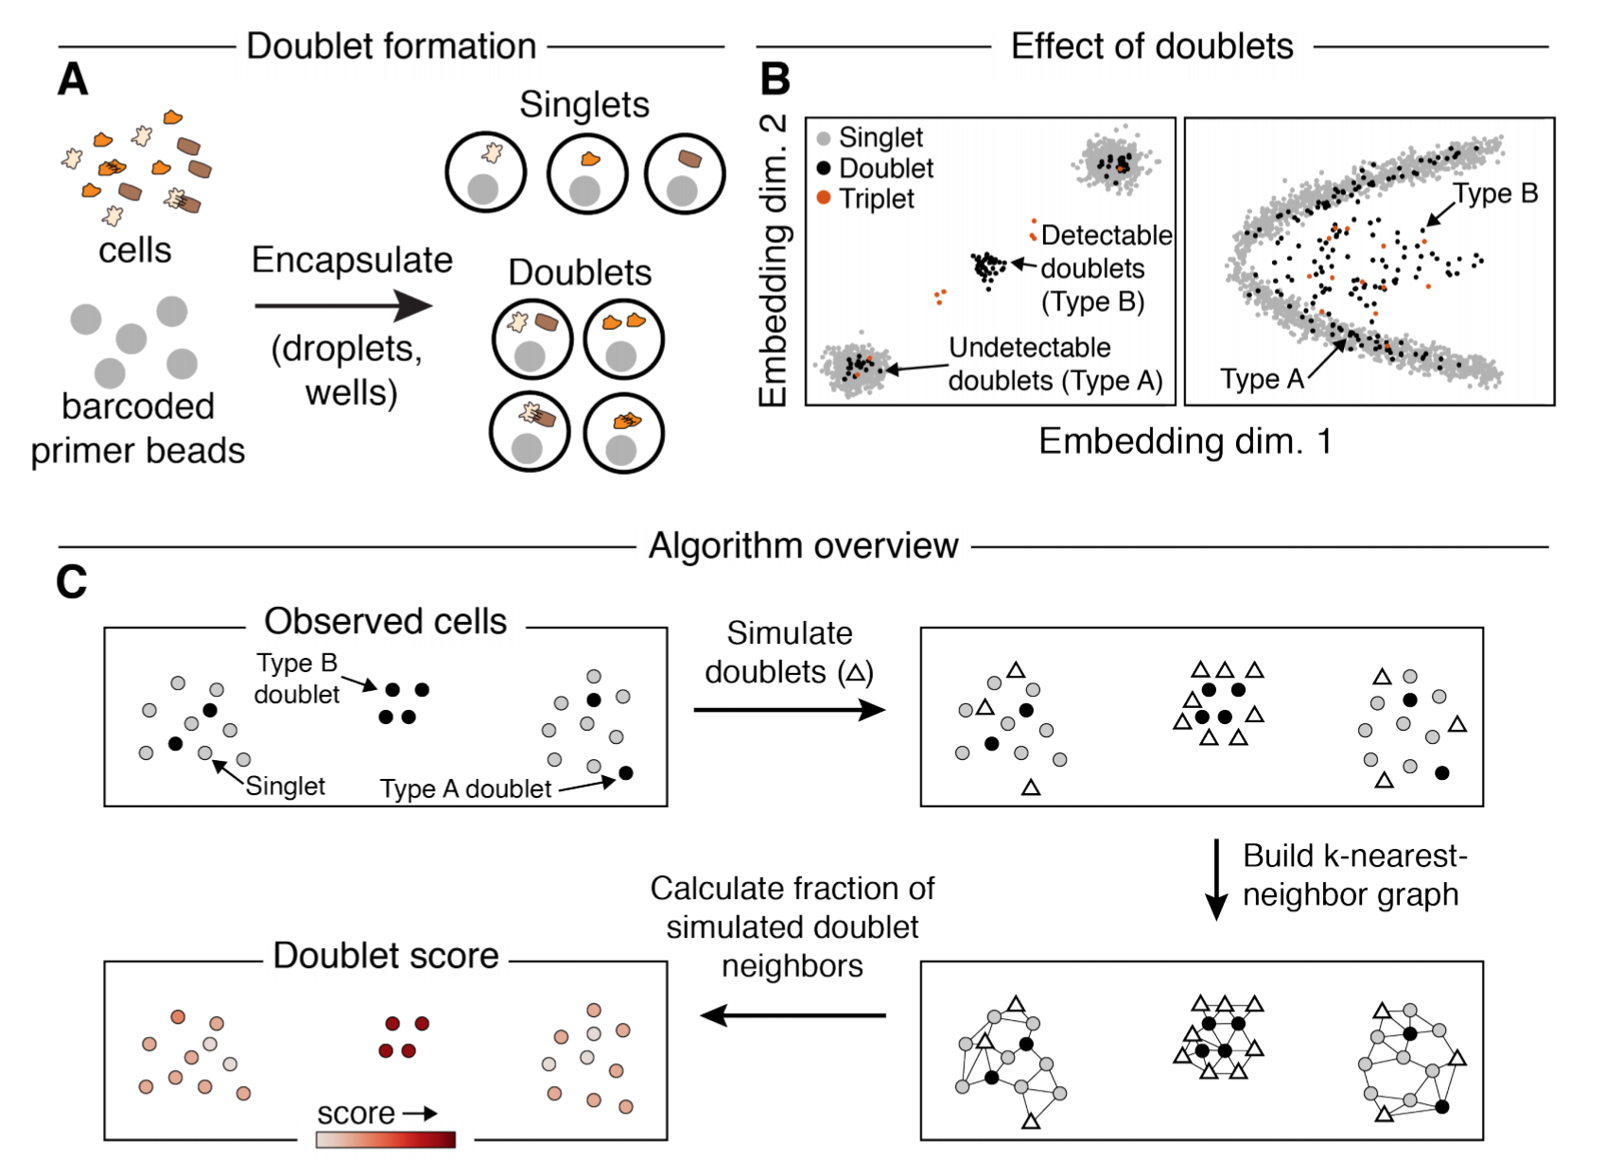
Scrublet: Computational Identification of Doublets
S. Wolock et al. Scrublet: computational identification of cell doublets in single-cell transcriptomic data, bioRxiv 2018 (DOI: 10.1101/357368)
Notes:
“randomize order” mt, wt, wt mt etc
CHECK FOR QUESTIONS

Slide 25
Introduction to Single Cell RNA Sequencing
Common applications of single cell RNA sequencing.
Overview of single cell RNA sequencing platforms.
Modified scRNA-seq workflows
Sample preparation and experimental design.
Effects of sample prep and sample type on analysis.
Notes:
The first step in single cell sequencing is deciding if you need scRNASeq for your question. Bulk vs scRNA
For a crispr screen the bulk would tell you about the phenotype you selected on, but not yield any information on the effect due to an individual k/o

Slide 26
Transcript Specific Library Prep
GFP labeled population
Identify cells in pooled CRISPR screens
Identify barcoded cells
V(D)J immune cell profiling
Identify labeled (GFP, mCherry) cells.
Enrich for genes of particular interest for your experiment.
Component1
Component2
Notes:
Brief digression into transcript specific library preparation

Slide 27
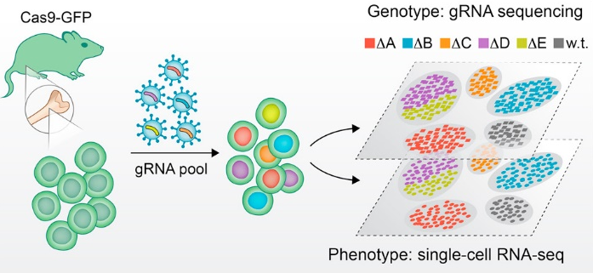
Transcript Specific Library Prep
CRISPR pool vector backbone must contain a transcribed poly-adenylated unique guide index (UGI), which can include a fluorescent marker
scRNA-seq library to phenotype cellular transcriptome (NextSeq/HiSeq)
gRNA-targeted library to ensure proper cell identification (MiSeq)
D.A. Jaitin et al., Dissecting Immune Circuits by Linking CRISPR Pooled Screens with Single-Cell RNA-Seq, Cell 2016 (doi: 10.1016/j.cell.2016.11.039)
A. Dixit et al., Perturb-Seq: Dissecting Molecular Circuits with Scalable Single-Cell RNA Profiling of Pooled Genetic Screens, Cell 2016 (doi10.1016/j.cell.2016.11.038)
Notes:
Brief digression into transcript specific library preparation

Slide 28
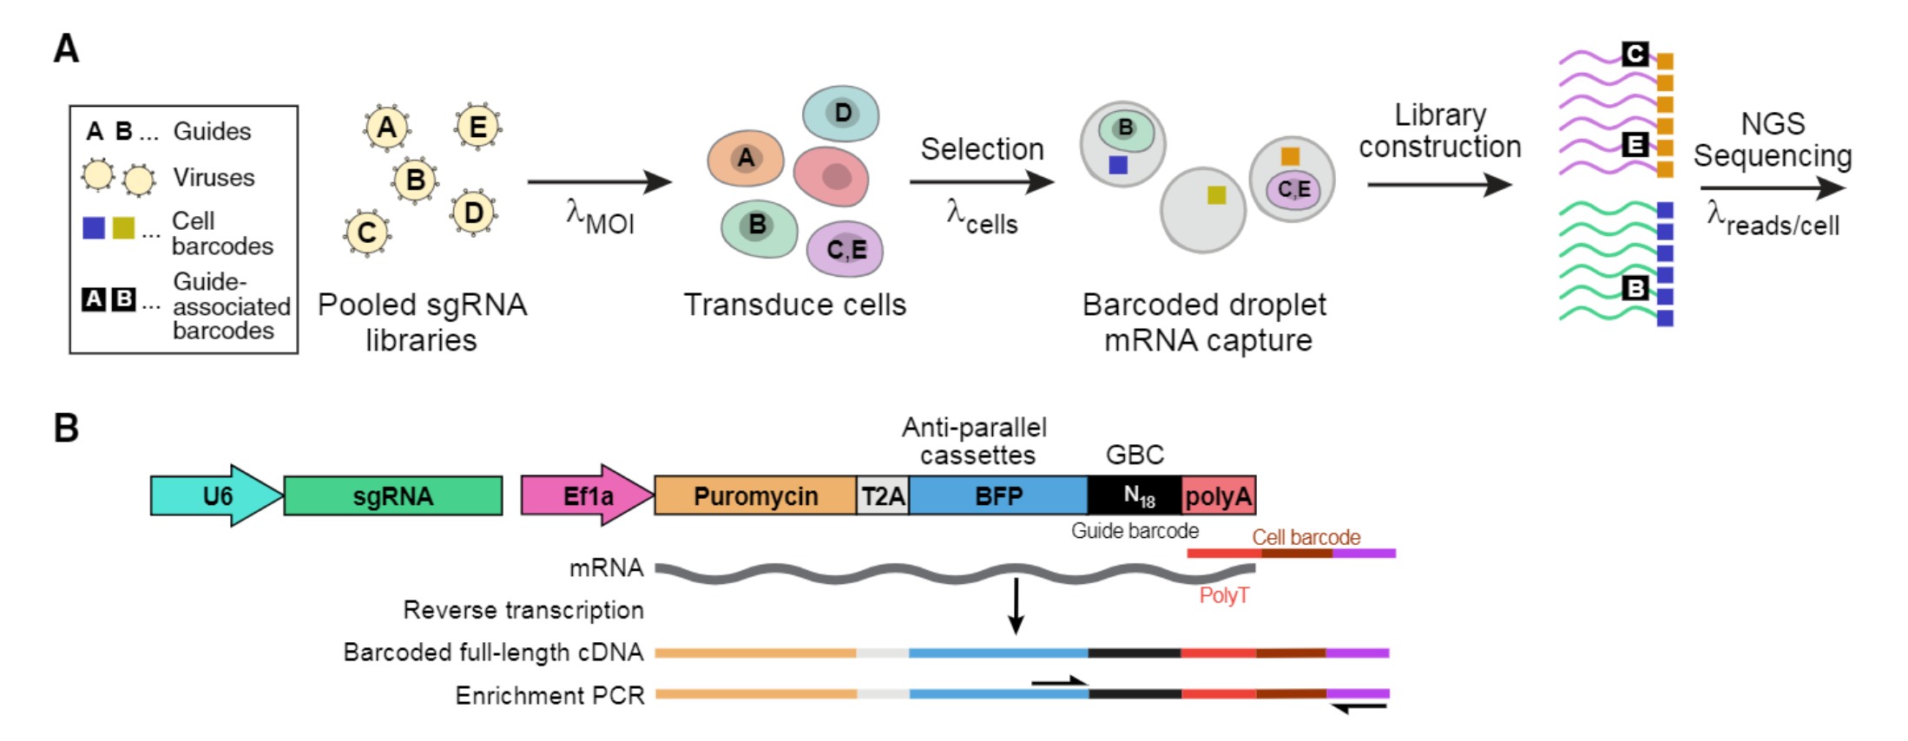
Transcript Specific Library Prep
A. Dixit et al., Perturb-Seq: Dissecting Molecular Circuits with Scalable Single-Cell RNA Profiling of Pooled Genetic Screens, Cell 2016 (doi10.1016/j.cell.2016.11.038)
Notes:
NEED fresh sample – can cryopreseve or try Nuc Seq. We talked about the dropout / stoicacitity issue – if only sequenced the single cell library pool – would not find the guide or BFP in every cell.

Slide 29
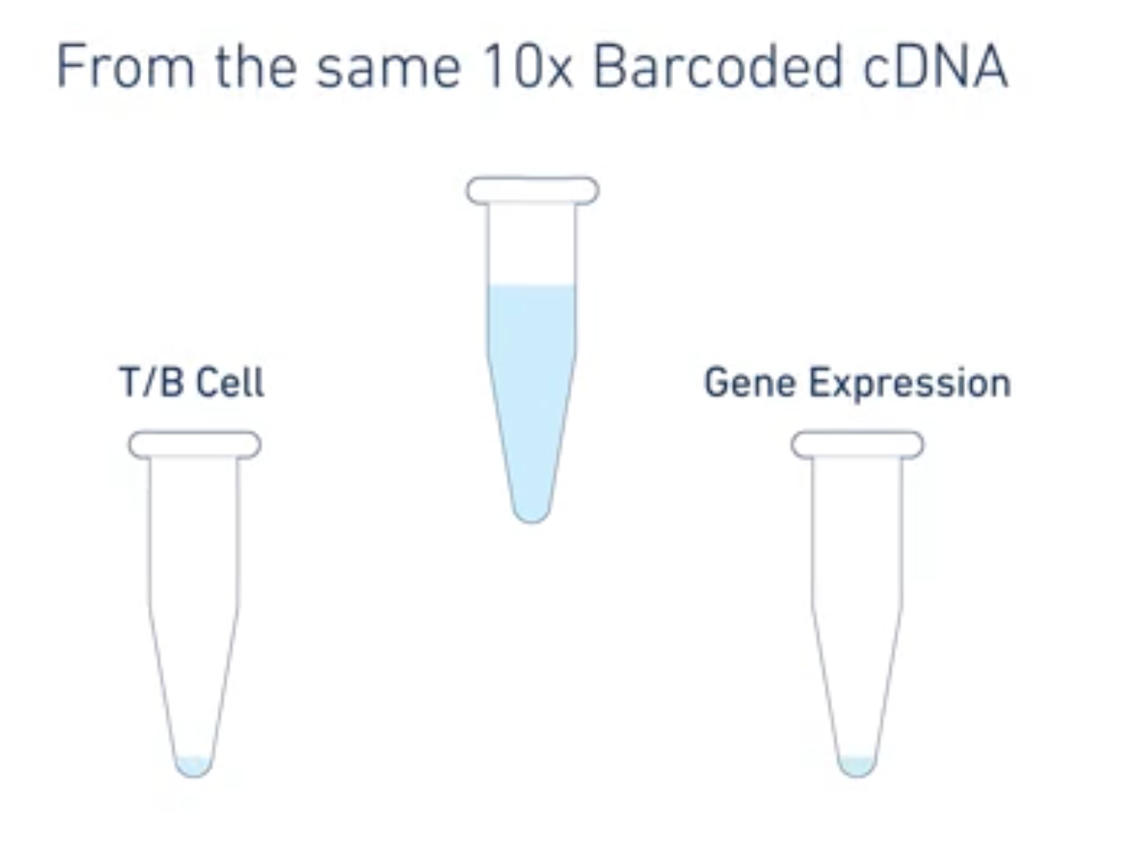
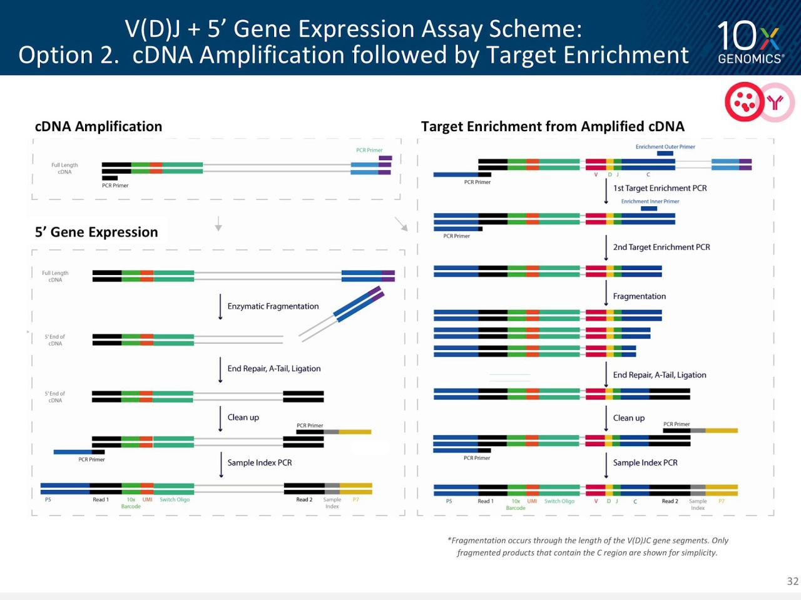
10x V(D)J Immune Profiling
https://www.10xgenomics.com/solutions/vdj/
Notes:
NEED fresh sample – can cryopreseve or try Nuc Seq. We talked about the dropout / stoicacitity issue – if only sequenced the single cell library pool – would not find the guide or BFP in every cell.

Slide 30
Transcript Specific Library Prep
Make standard library
NextSeq/HiSeq/NovaSeq sequencing to identify cell barcodes in sample
Make transcript specific library with aliquot of partially prepped library
MiSeq to identify cells with transcripts of interest
Match barcodes identified in both sequencing runs
Notes:
NEED fresh sample – can cryopreseve or try Nuc Seq

Slide 31
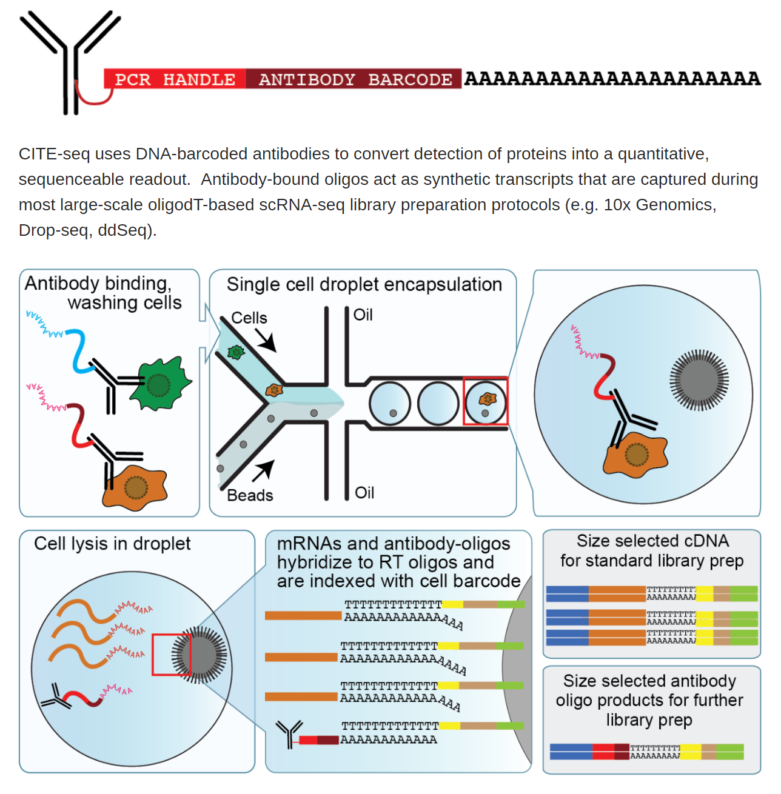
CITE-Seq / Cell Hashing
Cellular Indexing of Transcriptomes and Epitopes by Sequencing (CITE-seq)
CITE-seq uses DNA-barcoded antibodies to convert detection of proteins into a quantitative, sequenceable readout.
https://cite-seq.com/
Notes:
10x likes to say cost is ~12 cents per cell – but that is at the max cells, which has the highest doublet rate. It also

Slide 32
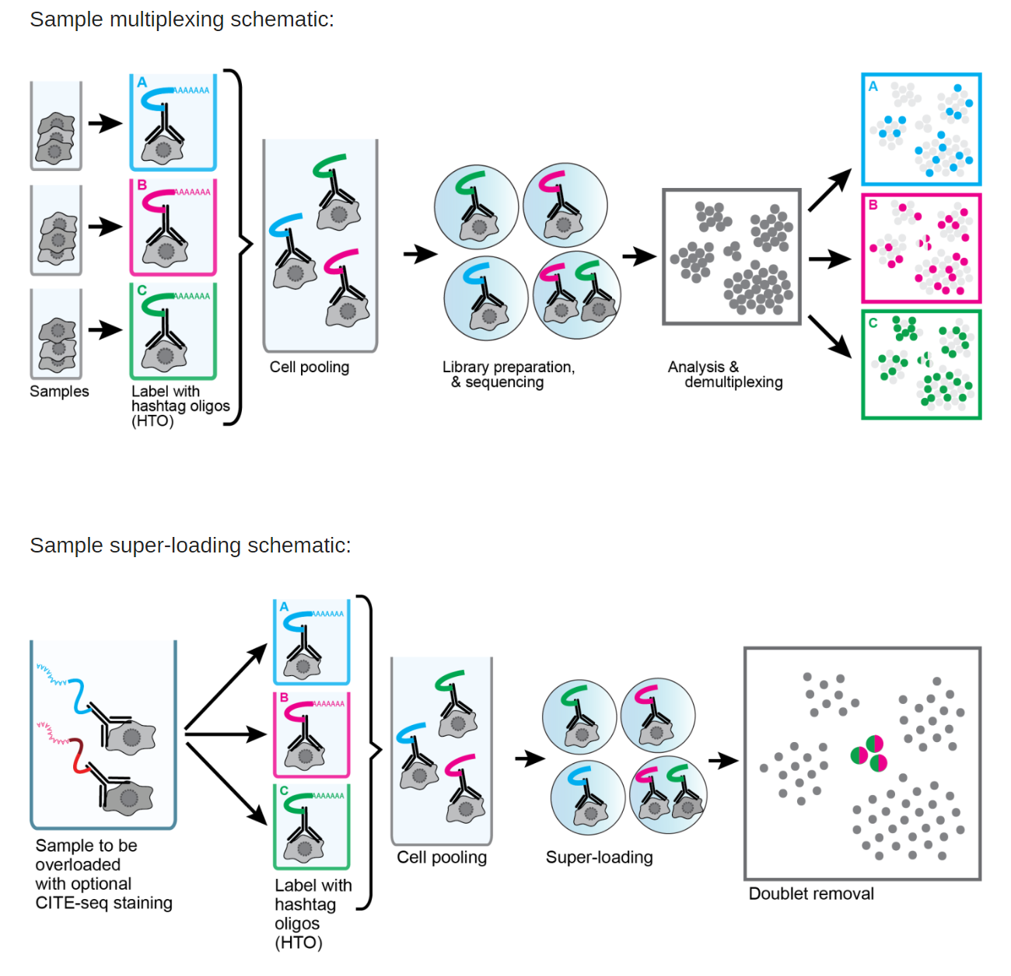
Cell Hashing / CITE-Seq
Cell Hashing is the same idea as CITE-seq just using ubiquitously expressed surface proteins.
Allows for multiplexing samples into a single encapsulation.
By sequencing tags alongside the cellular transcriptome, we can assign each cell to its sample of origin, and robustly identify doublets originating from multiple samples.
https://cite-seq.com/
Notes:
10x likes to say cost is ~12 cents per cell – but that is at the max cells, which has the highest doublet rate. It also

Slide 33
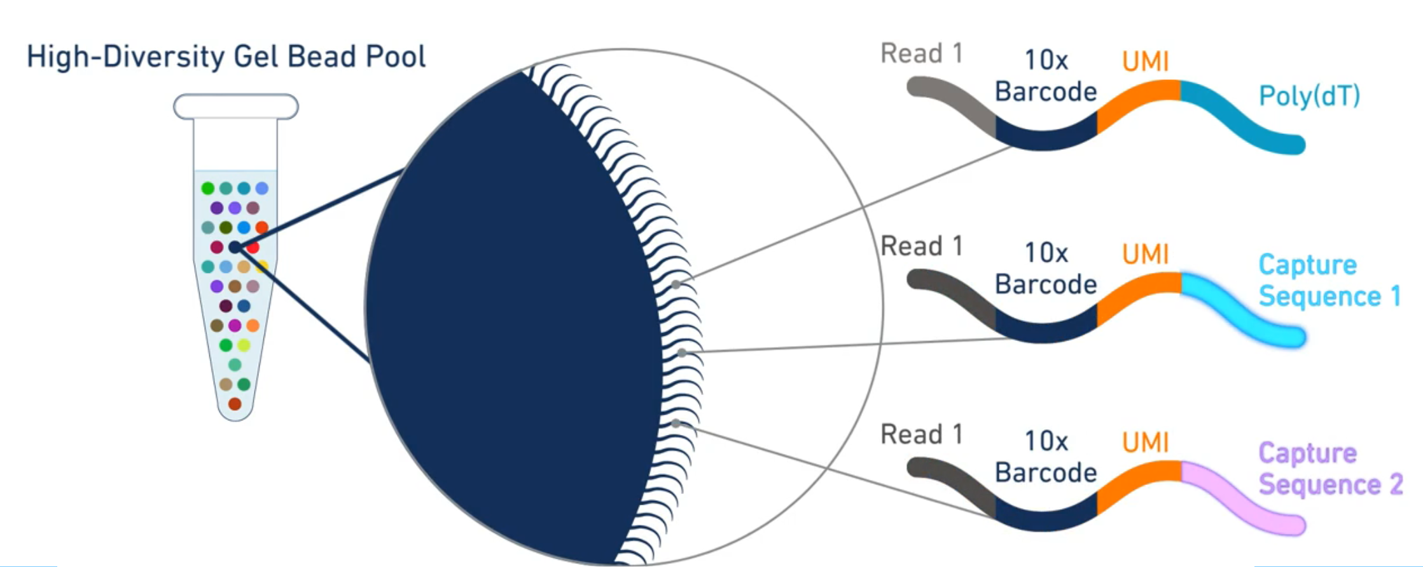
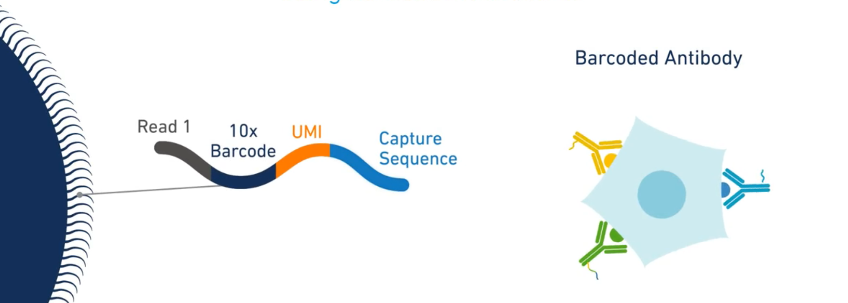
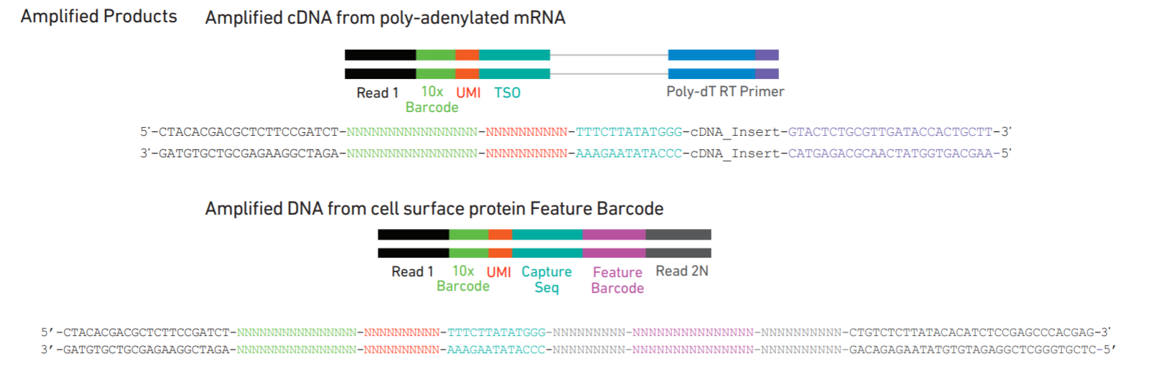
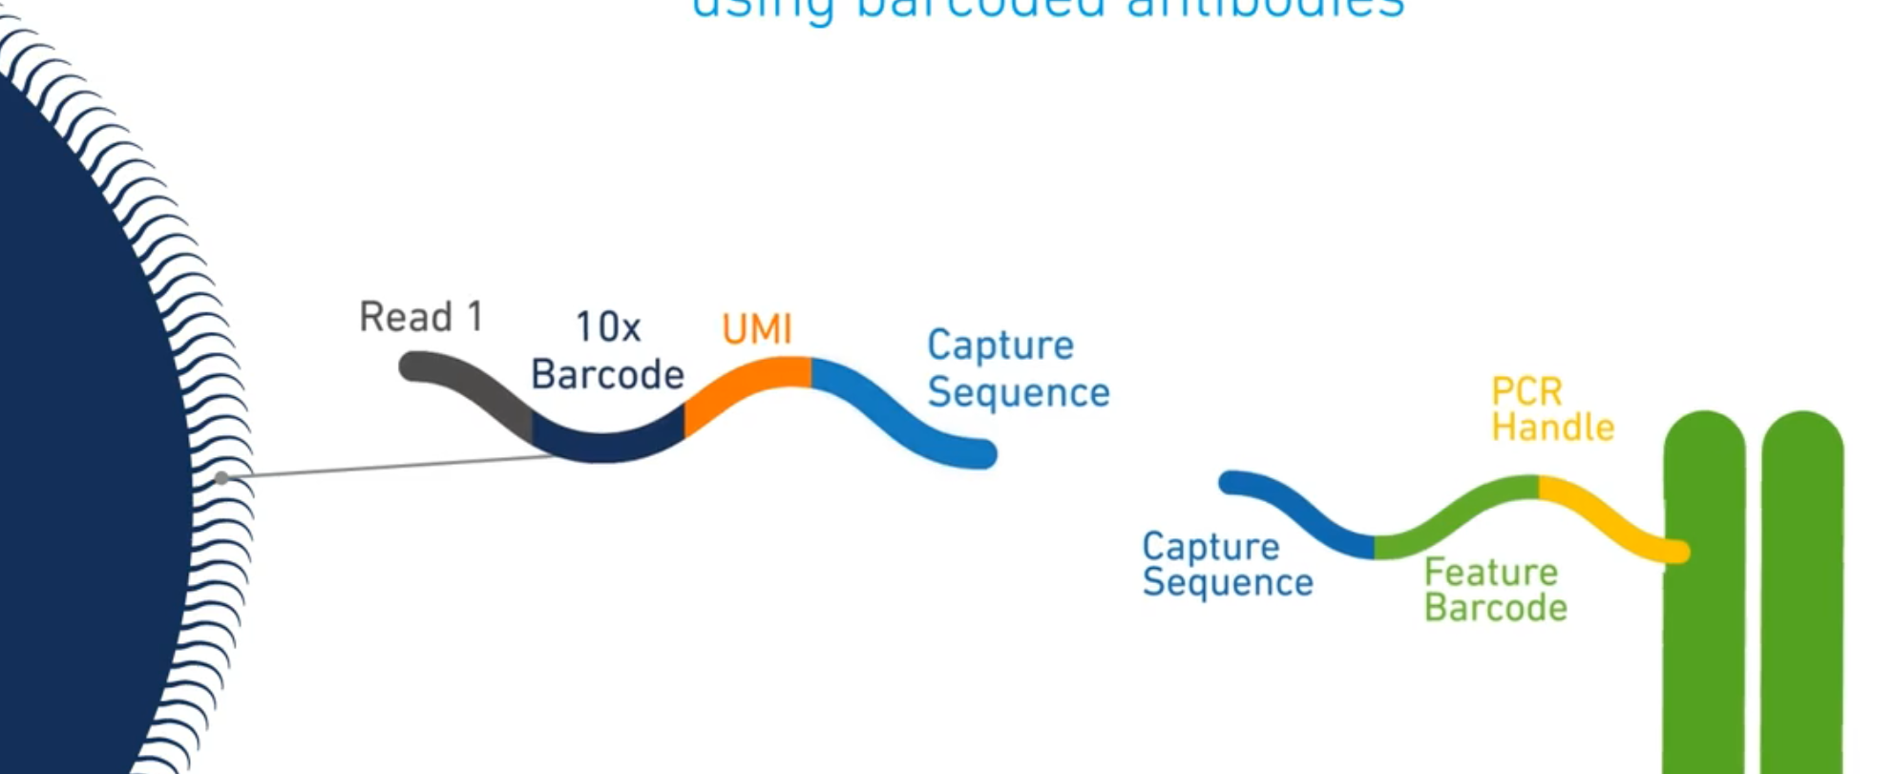
10x Capture Sequence / Feature Barcode
https://www.10xgenomics.com/solutions/single-cell/
Notes:
NEED fresh sample – can cryopreseve or try Nuc Seq. We talked about the dropout / stoicacitity issue – if only sequenced the single cell library pool – would not find the guide or BFP in every cell.

Slide 34
Comparison of Single Cell Methods
 | inDrops | 10x | Drop-seq | Seq-well | SMART-seq
Cell capture efficiency | ~70-80% | ~50-65% | ~10% | ~80% | ~80%
Time to capture 10k cells | ~30min | 10min | 1-2 hours | 5-10min | --
Encapsulation type | Droplet | Droplet | Droplet | Nanolitre well | Plate-based
Library prep | CEL-seq Linear amplification by IVT | SMART-seq Exponential PCR based amplification | SMART-seq Exponential PCR based amplification | SMART-seq Exponential PCR based amplification | SMART-seq Exponential PCR based amplification
Commercial | Yes | Yes | -- | -- | Yes
Cost (~$ per cell) | ~0.06 | ~0.2 | ~0.06 | -- | 1
Strengths | Good cell capture Cost-effective Real-time monitoring Customizable | Good cell capture Fast and easy to run Parallel sample collection High gene / cell counts | Cost-effective Customizable | Good cell capture Cost-effective Real-time monitoring Customizable | Good cell capture Good mRNA capture Full-length transcript No UMI
Weaknesses | Difficult to run | Expensive | Difficult to run & low cell capture efficiency | Still new! | Expensive
C. Ziegenhain et al., Comparative Analysis of Single-Cell RNA Sequencing Methods, Molecular Cell 2017 (doi: 10.1016/j.molcel.2017.01.023)
Notes:
Just remind us this was our methods overview. Droplet methods standard. Plate based methods give you full length info and Seqwell great – not really fully commercially availabled and still requires same minum’s we do.

Slide 35
Introduction to Single Cell RNA Sequencing
Common applications of single cell RNA sequencing.
Overview of single cell RNA sequencing platforms.
Sample preparation and experimental design.
Effects of sample prep and sample type on analysis.
Notes:
The first step in single cell sequencing is deciding if you need scRNASeq for your question. Bulk vs scRNA
For a crispr screen the bulk would tell you about the phenotype you selected on, but not yield any information on the effect due to an individual k/o

Slide 36
Single Cell Core Workflow
Consult
Sample Prep
Pilot Experiment
Data Analysis
Final Experiment
Good sample prep is the key to success.
A well planned pilot experiment is essential for evaluating sample preparation and for understanding the required number of cells.
Do not rush to the final experiment.
Notes:
Want to think about your experiment and not rush – I will go over the sample prep type of discussions and recommendations we give at the SCC – please feel free to ask questions

Slide 37
Single Cell Core Sample Repertoire
Multi-cellular animals
Radial tissue organization
Bilateral tissue organization
Acoelomates
Pseudocoelomates
Coelomates
Coelenterata
(Cnidaria)
Ctenophora
Platyhelminthes
(flatworms)
Eg. Acoels, Planaria
Aschelminthes
Three-banded panther worms
Hofstenia miamia
Fruitfly
Drosophila melanogaster
Annelida
Mollusca
Hemichordata
Arthropoda
Echinodermata
Crustacean
Parhyale hawaiensis
Bat star
Patiria miniata
Painted seaurchin
Lytechinus pictus
Chordata
Reptile
Mammal
Fish
Amphibian
Bird
Zebrafish
Danio rerio
Chick
Gallus gallus
Emu
Dromaius novaehollandiae
Homo sapiens
African clawed frog
Xenopus laevis
Axolotl salamander
Duck
Anas platyrhynchos
Macaque monkeys
Mus musculus
Notes:
Range of samples have looked at the SCC

Slide 38
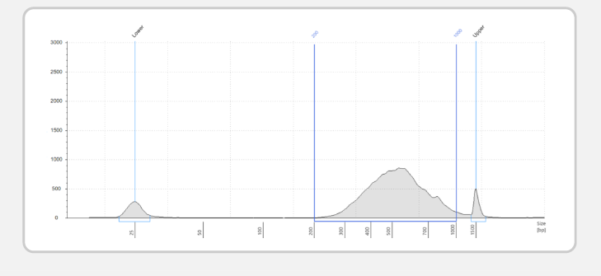
Single Cell Core Sample Repertoire
Primary cell/ tissue:
Whole embryo
Blood (immune cells)
Bone marrow (hematopoietic stem cells)
Embryonic stem cells
Gut, Lung, Stomach, Colon (epithelium)
Adipose tissue (non-adipocytes)
Hepatocytes
Brain and spinal cord (neurons, microglia, astrocytes)
Thymus
Various patient samples
Cells/ tissues grown in vitro:
Differentiated cells from iPSCs
Organoids
Single nuclear samples:
Brain and Kidney
Standard Library
Fly / Arthropod Library
Notes:
High viability is the key to good sample prep
Most of Nuc-Seq protocols are published on Brain samples – if you are then trying this on liver samples you should expect to spend weeks or months on optimization.

Slide 39
Experimental Decision Making
Is your sample fairly homogeneous?
Yes
Bulk RNA-Seq
No
scRNA-seq
Do you want full length transcripts/splice variants?
Is our sample limited in cell number (<10,000 cells)?
Yes
SMART-Seq/plate based method
No
Droplet-based method
Notes:
100,000-1 Million cells/ml for droplet methods. 100-1000 cells/ul

Slide 40
Key to Success: Sample Preparation
High cell viability (>90-95% preferred)
Minimal free-floating RNA
Single cell suspension
Dissociation protocol is cell type dependent
Primary samples are much more difficult
Cryopreservation or Nuc-Seq works on some sample types
Notes:
High viability is the key to good sample prep
Most of Nuc-Seq protocols are published on Brain samples – if you are then trying this on liver samples you should expect to spend weeks or months on optimization.

Slide 41
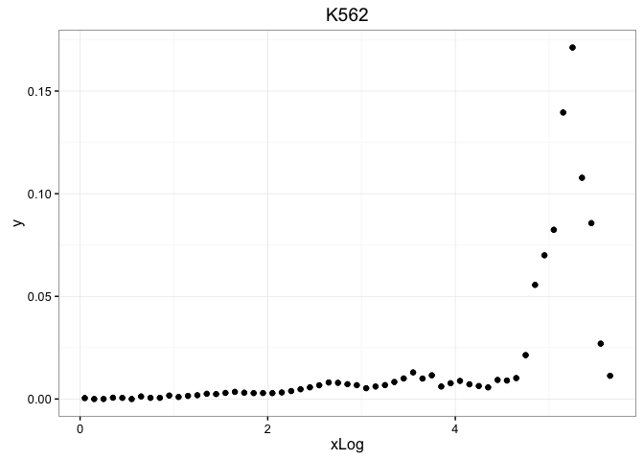
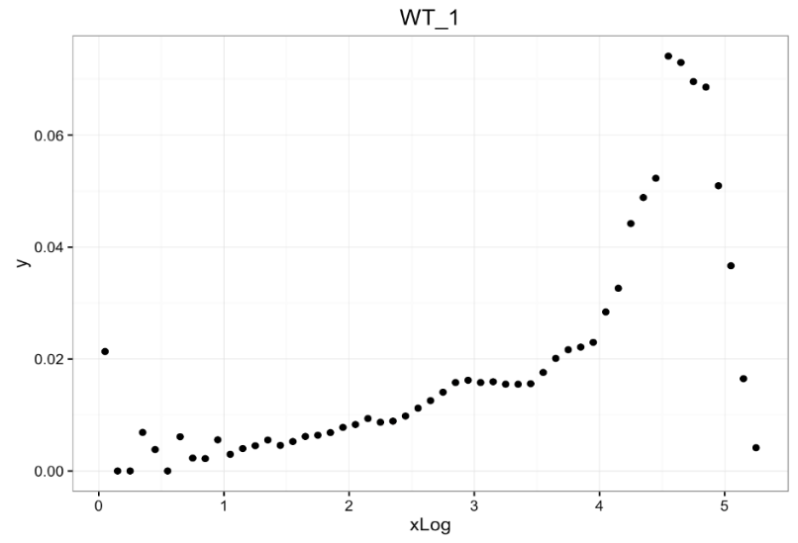
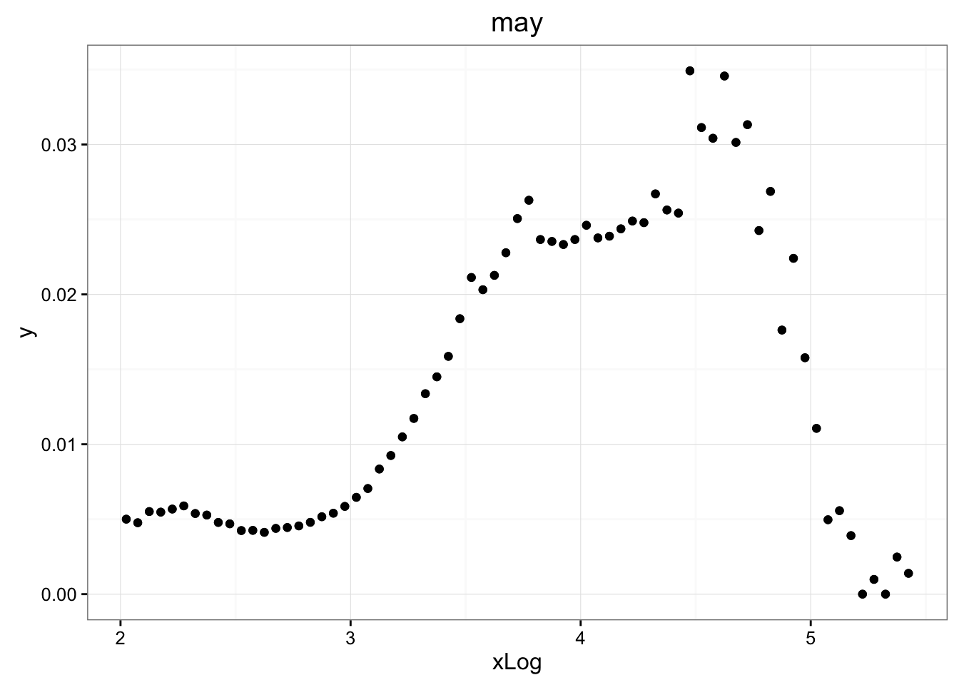
Key to Success: Sample Preparation
Good single cell suspension. No clumps and minimal debris.
More than 90% viability is ideal.
Cell membrane integrity is required until they are encapsulated.
Nanowell-based barcoding platform
Droplet-based barcoding platform
% of cell population
More background = More wasted reads
Reads/ cell barcode
Reads/ cell barcode
Reads/ cell barcode
Ideal data
Free-floating RNA
Notes:
High viability is the key to good sample prep
Most of Nuc-Seq protocols are published on Brain samples – if you are then trying this on liver samples you should expect to spend weeks or months on optimization.

Slide 42
Key to Success: Sample Preparation
What is your sample of interest? And how would you obtain that?
Which population in a tissue should be examined?
Does it require some sort of enrichment?
Solid tissue
Dissociation
Adherent cell culture
Enrichment
Quality check
Suspended cell culture
Liquid tissue
Notes:
High viability is the key to good sample prep
Most of Nuc-Seq protocols are published on Brain samples – if you are then trying this on liver samples you should expect to spend weeks or months on optimization.

Slide 43
Sample preparation protocol varies by cell-type
Enzyme-based dissociation- trypsin, collagenase, liberase, accutase.
Gentle washes.
Dead cell removal kit, filtering out the debris.
Density gradient (Ficoll, Optiprep)
Note: the final sample buffer should be devoid of heparin, Ca²⁺, Mg²⁺ and EDTA
Solid tissue
Dissociation
Adherent cell culture
Enrichment
Quality check
Suspended cell culture
Magnetic bead selection (MACS)
FAC sorting
Liquid tissue
Cell concentration
Cell Viability (Trypan Blue)
Notes:
High viability is the key to good sample prep
Most of Nuc-Seq protocols are published on Brain samples – if you are then trying this on liver samples you should expect to spend weeks or months on optimization.

Slide 44
Enrichment Methods: Pros & Cons
FACS (Fluorescence activated cell sorting)
Pros:
Enrichment is robust.
Yields good single cell suspension.
Live/dead sorting by DNA stains, eg. DAPI.
Cons:
Uses high pressure to sort the cells.
Can introduce bias in the experiment.
Long sample prep protocol.
MACS (Magnetic activated cell sorting)
Pros:
Gentile on cells and faster protocol
Greater number of cells can be processed.
Not limited by FACS sorter availability.
Cons:
Number of available surface marker-conjugated to magnet is limited.
Enrichment is not precise. Not applicable for rare population.
Notes:
Technically can run the droplet methods with fewer cells, but the cost per cell increases rapidly. 10x for example is about 20C per cell, but if you only collect a thousand cells that price is over $1.25 per sample.

Slide 45

Sample Preparation: increasing cell viability
Mild dissociation reagent (TrypLE, StemPro, Accutase, Liberase)
Shorten dissociation time
Reduce dissociation temperature
Using ROCK inhibitor/ apoptosis inhibitor (esp. epithelial cells)
Avoid cell pelleting
Avoid FACS sorting on more fragile cell types
Try magnetic activated cell sorting (MACS)
Notes:
NEED fresh sample – can cryopreseve or try Nuc Seq

Slide 46
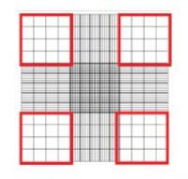
Sample Preparation: cell numbers
Droplet methods have a 10,000-25,000 cell minimum
need ~50-100 cells with a unique transcriptome to identify a population cluster
100-1000 cells per ul = 100,000-1,000,000 cells per ml
Count cells by hemocytometer – do not trust sorter counts
counts from the sorter are often ½ of actual cell counts
Try negative selection to remove unwanted cells
Sort on a broader marker to increase cell numbers
For unavoidably low density samples
spike the sample with cells with distinct expression profile
Notes:
Technically can run the droplet methods with fewer cells, but the cost per cell increases rapidly. 10x for example is about 20C per cell, but if you only collect a thousand cells that price is over $1.25 per sample.

Slide 47
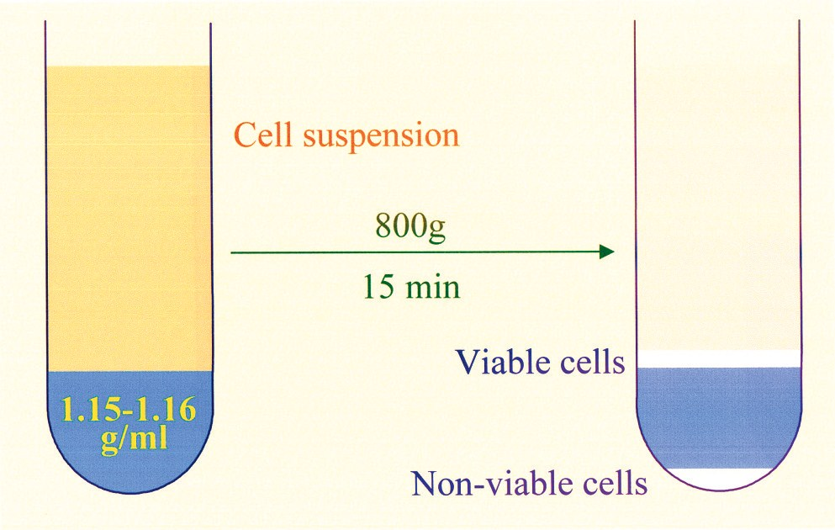
Sample Preparation: single cell suspension
Use appropriate cell strainer to get rid off clumps.
Use metabolically inert, non-toxic density gradient media to fractionate cells.
We routinely use 15% Opti-prep to keep cells in single cell suspension while loading sample, but the concentration might vary from cell to cell.
Make sure final buffer does not contain calcium, EDTA, or heparin (inhibit RT).
Notes:
NEED fresh sample – can cryopreseve or try Nuc Seq

Slide 48
Sample Preparation: buffers
Suggest final sample prepared in:
PBS with 0.1-1% BSA
Defined media without calcium, magnesium, or EDTA
2% FBS in defined media without calcium or EDTA has worked for some users.
Make sure buffer does not contain calcium, magnesium, EDTA, or heparin (inhibit RT).
Notes:
NEED fresh sample – can cryopreseve or try Nuc Seq

Slide 49
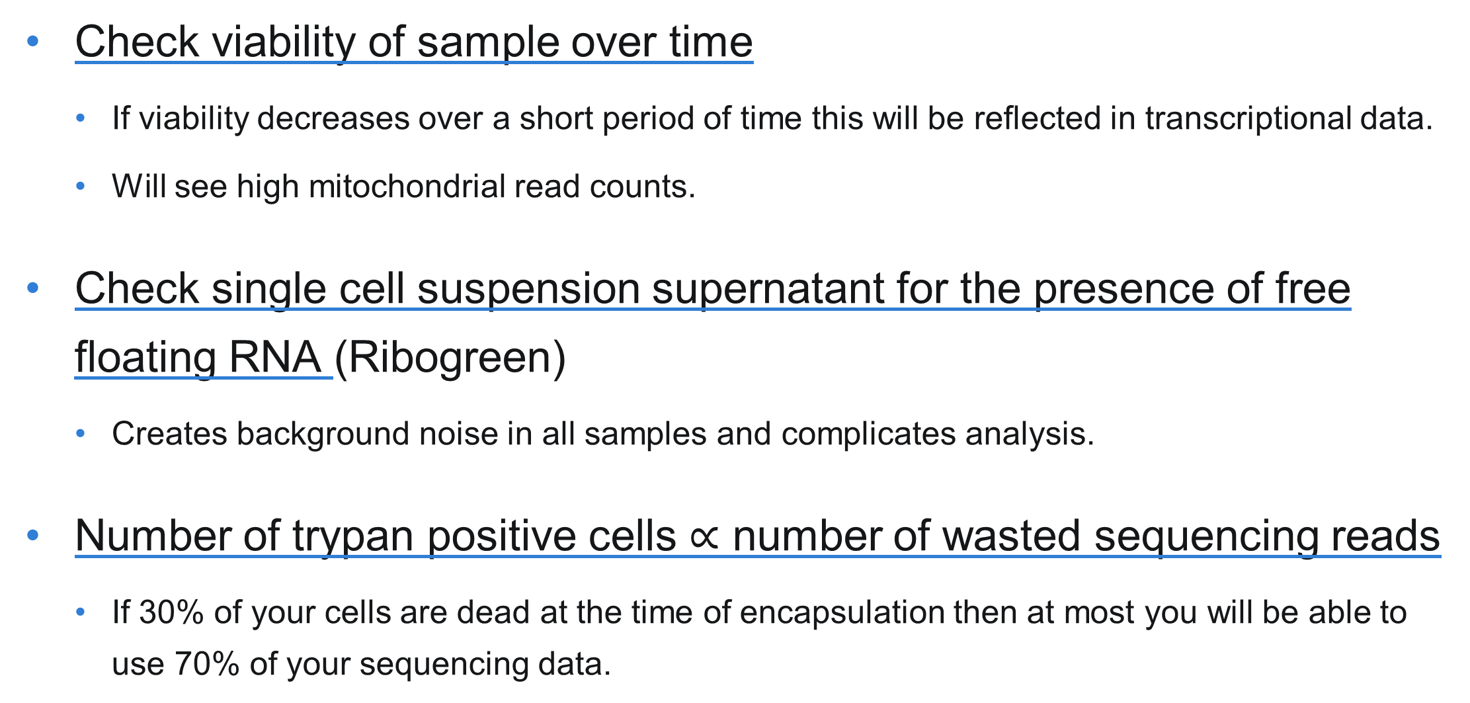
Sample Preparation: viability checks
Check viability of sample over time
If viability decreases over a short period of time this will be reflected in transcriptional data.
Will see high mitochondrial read counts.
Check single cell suspension supernatant for the presence of free floating RNA (Ribogreen)
Creates background noise in all samples and complicates analysis.
Number of trypan positive cells $∝$ number of wasted sequencing reads
If 30% of your cells are dead at the time of encapsulation then at most you will be able to use 70% of your sequencing data.
Notes:
NEED fresh sample – can cryopreseve or try Nuc Seq

Slide 50
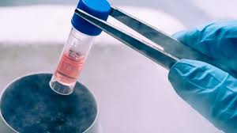
Sample Preparation: cryopreservation
Several papers have come out using various cryopreservation techniques on samples (PBMC’s or cell lines).
Success of cryopreservation is dependent on the sample type.
Have seen this worked well on blood and immune cells.
Key is the viability of the cells upon rehydration.
Consider Nuc-Seq as an option from cryopreserved cells.
Alles, J. et al. Cell fixation and preservation for droplet-based single-cell transcriptomics. BMC Biol. 2017 (doi: 10.1186/s12915-017-0383-5)
Guillaumet-Adkins, A. et al. Single-cell transcriptome conservation in cryopreserved cells and tissues. Genome Biol. 2017 (doi: 10.1186/s13059-017-1171-9)
Habib, N. et al. Massively parallel single-nucleus RNA-seq with DroNc-seq. Nat. Methods 2017 (doi: 10.1038/nmeth.4407)
Notes:
NEED fresh sample – can cryopreseve or try Nuc Seq

Slide 51
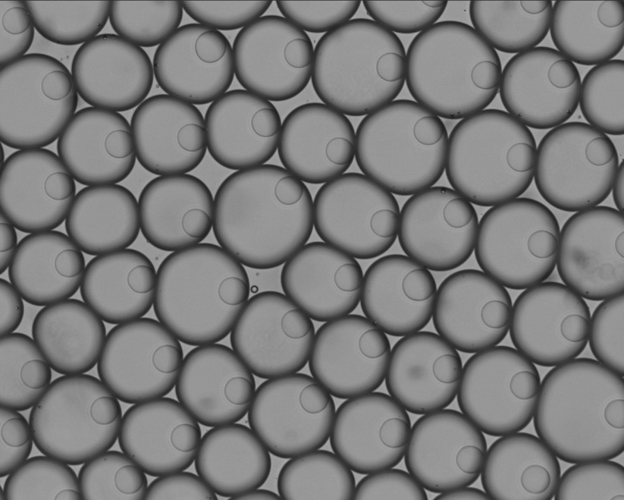
Sample Preparation: Nuc-Seq
Extract nuclei from sample of interest.
Removes transcriptional noise from dead/dying cells.
Most often used for neuronal samples.
Good for flash frozen clinical samples.
Several studies have shown nuclear transcripts represent a considerable portion of the whole cell transcripts.
Analysis is more difficult due to presence of introns and non-coding RNA.
https://www.frontiersin.org/articles/10.3389/fcell.2018.00108/full#B12
Notes:
NEED fresh sample – can cryopreseve or try Nuc Seq

Slide 52
Best practices to obtain high quality sample
Optimize a dissociation protocol that is best-suited for your cell type of interest.
Short sample prep time.
Maintaining low temperature.
Gentle treatment
gentle lysis condition (low temp, short time)
short FACS time, slow sorting, bigger nozzle (in certain cases)
Gentle centrifugation (300-500xg) and resuspension
Removing debris by filter or density medium
Include BSA (up to 1%) or FBS (up to 2%) in final buffer.
Notes:
NEED fresh sample – can cryopreseve or try Nuc Seq

Slide 53
Resources for scRNA-seq Sample Prep
https://www.protocols.io/
https://support.10xgenomics.com/single-cell-gene-expression/sample-prep
https://community.10xgenomics.com/

Slide 54
Single Cell Core Workflow
Consult
Sample Prep
Pilot Experiment
Data Analysis
Final Experiment
Good sample prep is the key to success.
A well planned pilot experiment is essential for evaluating sample preparation and for understanding the required number of cells.
Do not rush to the final experiment.
Notes:
Want to think about your experiment and not rush – I will go over the sample prep type of discussions and recommendations we give at the SCC – please feel free to ask questions

Slide 55
Best Practices for Experimental Design
Include biological replicates.
Perform drug/treatment/model vs control on the same day.
Randomize the order of samples run on different days.
Use same sex littermates as controls in mouse experiments.
Our experience is that library prep is the largest source of batch effect.
Collect all your samples in one study together then prep as one large library group.
Notes:
While your single sample has many thousands of cells. Weird things can still happen. You need to have separate biological replicates to ensure the validity of your data.
You want to have treatment vs control on the same day

Slide 56
Best Practices for Experimental Design
Pilot Study Experimental Design
Control vs diseased animal
Each sample requires pooling several animals.
Control and diseased littermates pooled for a single sample.
Both control and diseased samples run on same day.
The entire experiment is repeated on a second day running samples.
Load samples in opposite order.
Libraries from the four single cell samples are prepared as one batch.
Sequencing and analysis performed
Check that sample prep was of good quality.
Determine that the desired information can be obtained from the experiment.
Notes:
While your single sample has many thousands of cells. Weird things can still happen. You need to have separate biological replicates to ensure the validity of your data.
You want to have treatment vs control on the same day

Slide 57
Introduction to Single Cell RNA Sequencing
Common applications of single cell RNA sequencing.
Overview of single cell RNA sequencing platforms.
Sample preparation and experimental design.
Effects of sample prep and sample type on analysis.
Notes:
The first step in single cell sequencing is deciding if you need scRNASeq for your question. Bulk vs scRNA
For a crispr screen the bulk would tell you about the phenotype you selected on, but not yield any information on the effect due to an individual k/o

Slide 58
Single Cell Data Analysis
Align with Kalisto
Transcript compatibility counts
Identify cell barcodes and UMI
Downstream Analysis
Correct and filter barcodes
Quality control and clustering
Align with Rapmap
Scaled counts per transcript
Provided by the Harvard School of Public Health Chan Bioinformatics Core
Notes:
NEED fresh sample – can cryopreseve or try Nuc Seq

Slide 59
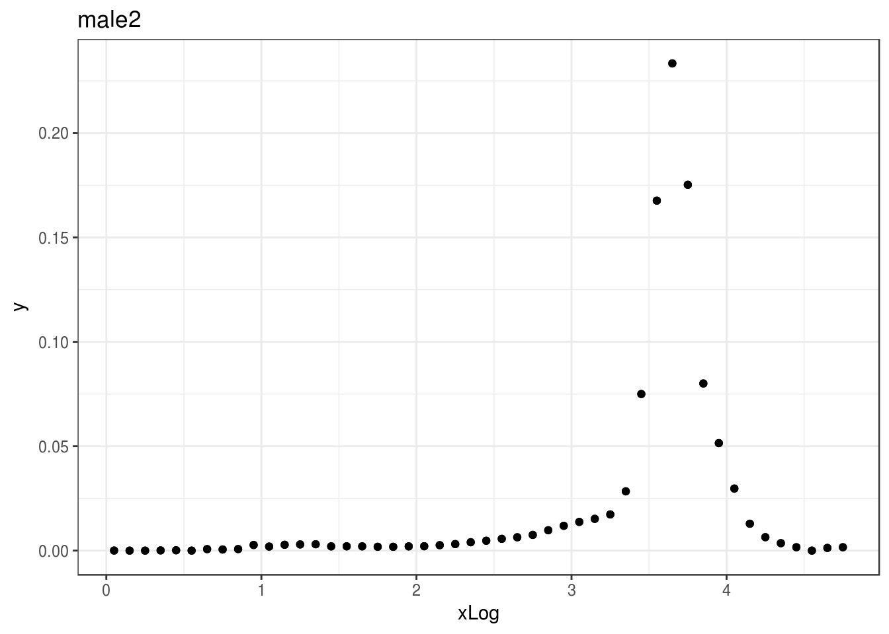
How Sample Prep Effects Data
Ideal sample Messier Distribution Failed Run common free floating RNA
Proportion of population
Log10 reads per cell barcode
Cut off usually remove any cell with < 10,000 / 20,000 barcodes per cell
It is normal for single cell RNA-seq data to contain a large number of low complexity barcodes.
Exact threshold will depend on sample
Provided by the Harvard School of Public Health Chan Bioinformatics Core
Notes:
Want a high number of reads per cell barcode – messy when cells sick or dead

Slide 60
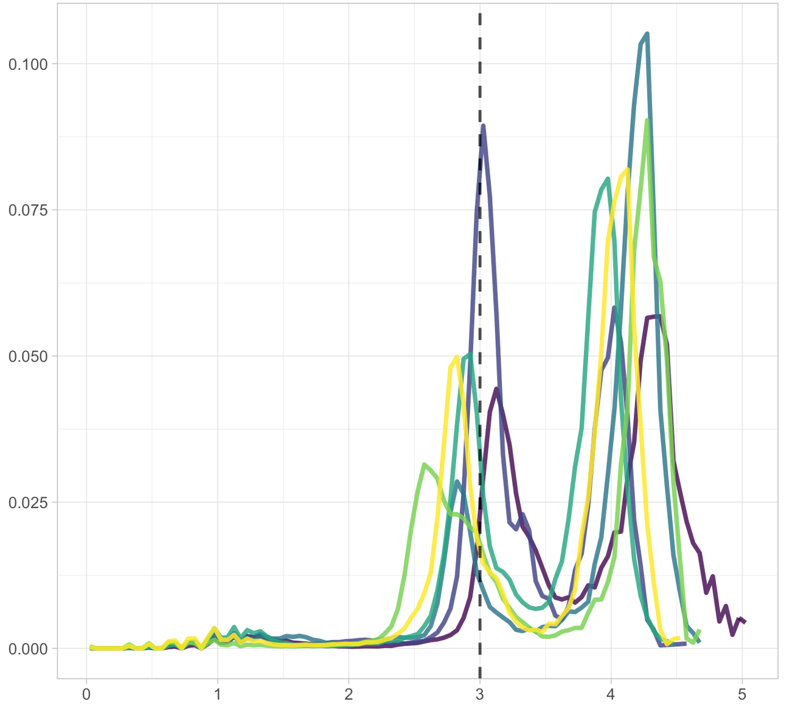
How Sample Type can Effect Data
Proportion of Cells
Log10 Reads per cell barcode
Bimodal peak is due to sample type. (infiltrating immune cells in tumor)
Lower peak can get filtered out in analysis.
May want to analyzer each peak separately.
Provided by the Harvard School of Public Health Chan Bioinformatics Core
Notes:
NEED fresh sample – can cryopreseve or try Nuc Seq

Slide 61
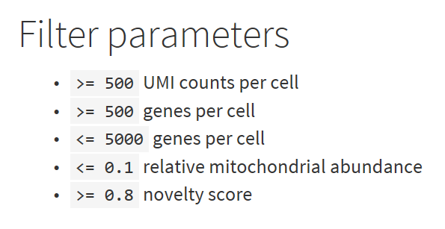
Data Analysis: Quality Control (QC) metrics
Reads per cell: How many reads assigned to a given cell barcode
UMI per cell: “Novelty” score looks for greater diversity genes per UMI
Genes detected: Genes with a non-zero count measurement per cell
Mitochondrial counts ratio: Biomarker for cellular stress
Provided by the Harvard School of Public Health Chan Bioinformatics Core
Notes:
Bullet 2 – again as long as this is ok given biology of the system.

Slide 62
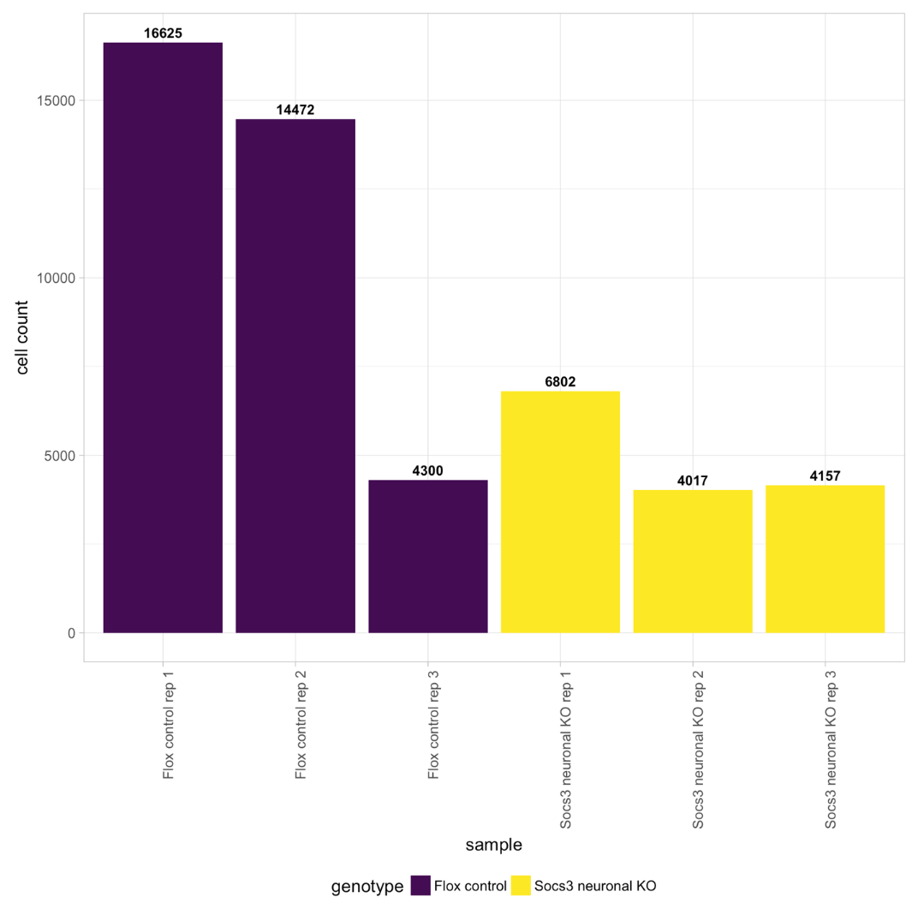
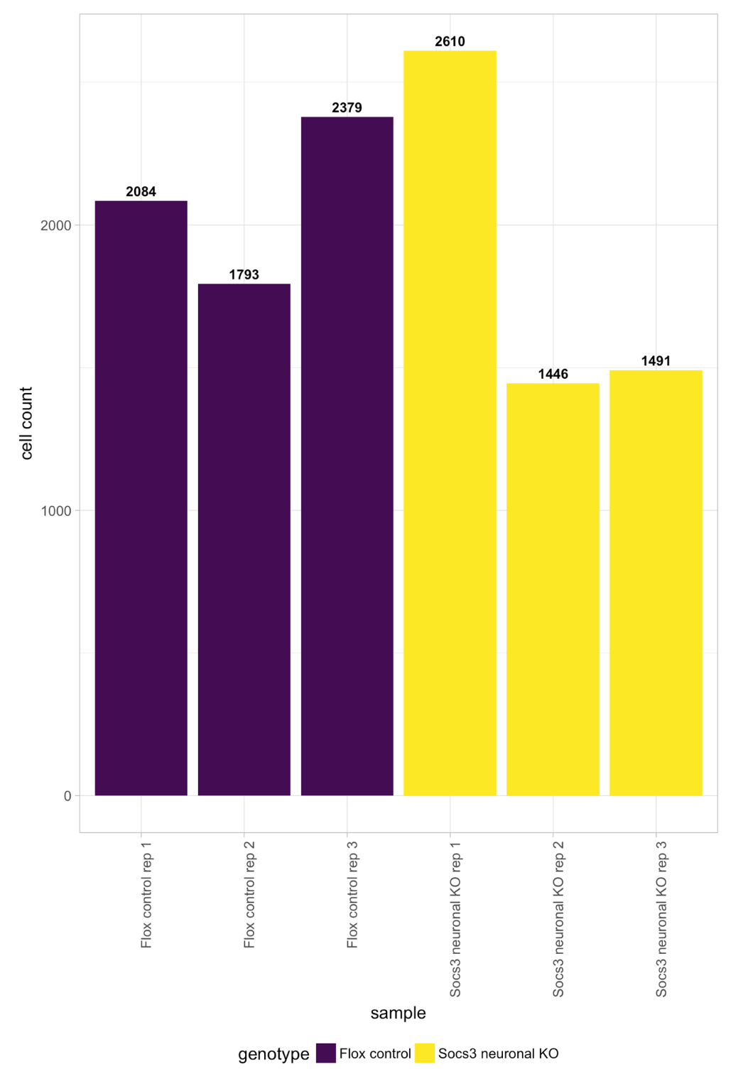
Data Analysis: filtering & correction
Pre-Filtering
Post-Filtering
Libraries were of 3,000 cells. Post-filtering retains 50-80% of cells
Provided by the Harvard School of Public Health Chan Bioinformatics Core
Notes:
Bullet 2 – again as long as this is ok given biology of the system.

Slide 63
Final thoughts on scRNA-seq
Practice your sample prep protocol. KEY to SUCCESS
Start with a pilot sample set to ensure your protocol is working.
Do not make your scRNA-seq run day the first day you run through the whole protocol.
Be sure sequencing core understands the specific sequencing parameters needed for your scRNA-seq library.
qPCR
Precise quantitation is key to good clustering / sequencing

